Slide 1
The Application of AI Detection Algorithms in Stamping

Slide 2
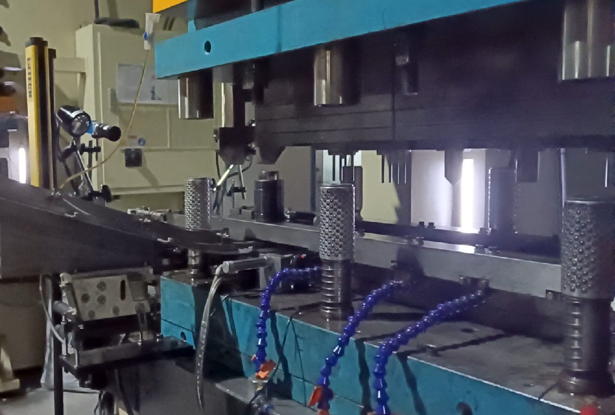
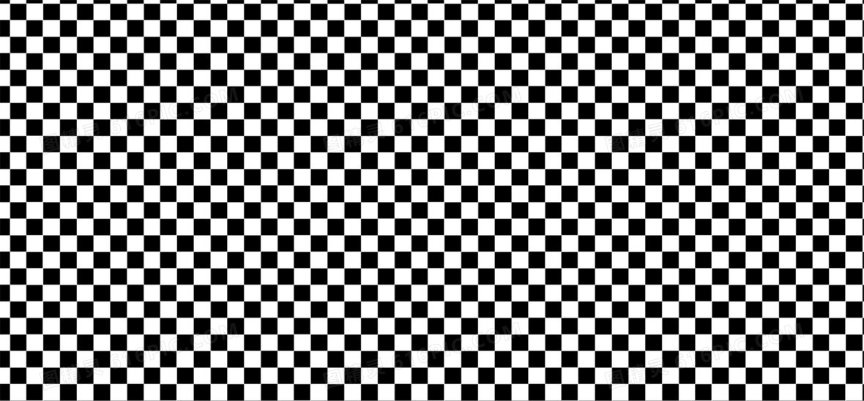
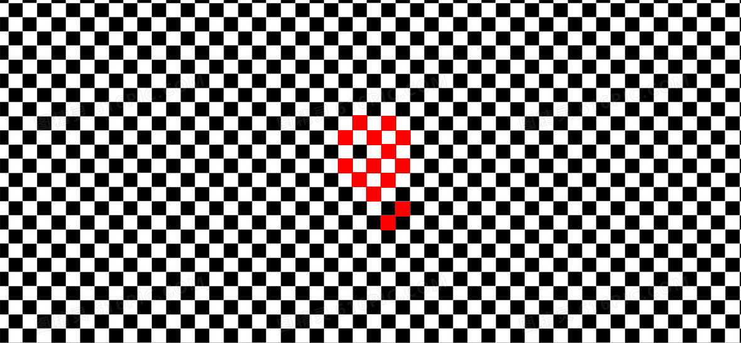
AI Detection Algorithms - Monitoring Pain Points
in Stamping Processes
Challenges of Traditional Visual Inspection in Stamping Environment
Problem 1: Material Offset
Problem 2: Reflection
Problems of Traditional Visual Inspection: Prone to False Judgment
During stamping processes such as blanking, bending, and drawing, the friction between the punch and the material edge during mold movement will cause the material to have a slight offset or slight deformation after forming, thereby causing imaging changes.
Meanwhile, due to the reflective properties of metal materials, in actual production, changes in ambient light and splashing of oil contamination during production easily cause irregular and random white reflections in the images. Additionally, uneven injection of stamping oil in the production process can also lead to imaging changes inside the mold.
Both of the above issues have no substantial impact on stamping production, but they can alter the images captured by machine vision. Traditional visual inspection adopts a template-based pixel comparison logic, and changes in pixels will lead to visual inspection false judgments.
The material will be displaced when the punch rises.
Pixels of the Simulated Real-time Image
Punching Die
Pixels of the Simulated Template
Ambient Light Flaring
Material
Pixel Comparison
Blanking Die

Slide 3
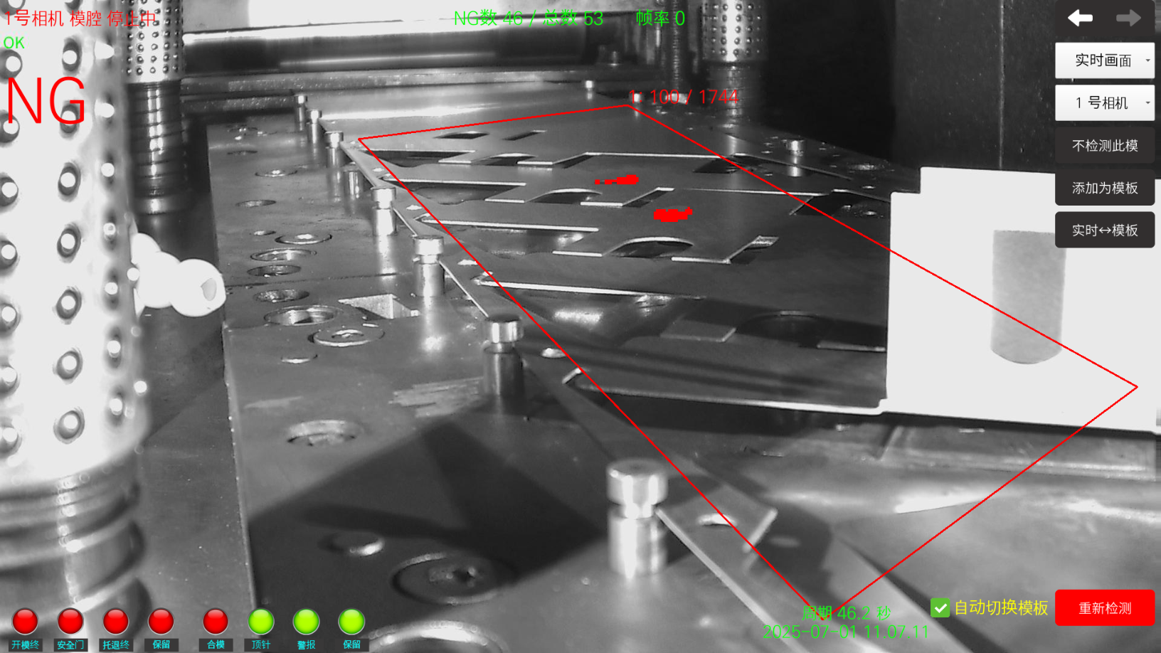
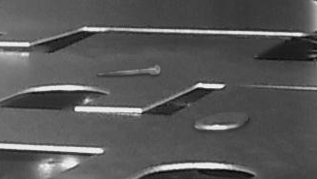
AI Detection Algorithms -
Reduce False Alarms/Foreign Object Detection
Foreign Object Detection in Stamping Environment
High Detection Accuracy
Low False Alarm Rate
Original Image of Foreign Object
Foreign Object Completely Identified

Slide 4

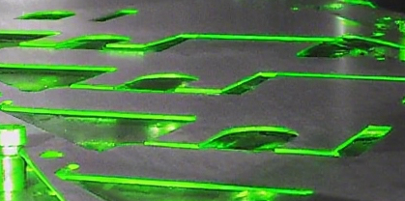
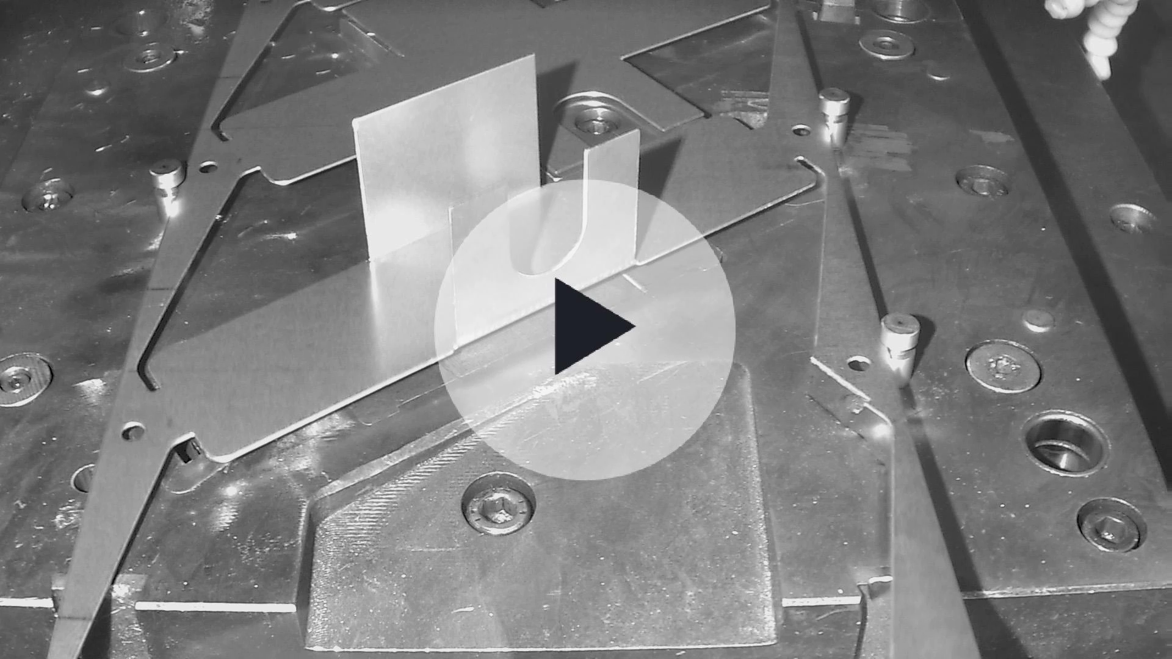

AI Detection Algorithms -
Explanation of AI Model Logic
Traditional Visual Upgrade → AI Visual Inspection
False Judgment of Material End Displacement
False Judgment Caused by Light Brightness Variation
False Judgment due to Uneven Stamping Oil
Our company's self-developed stamping AI detection algorithm can input the structural features of multiple qualified templates and train them into a unique model for the stamping die. During actual production, it adopts the template feature comparison logic to perform feature comparison on the material for each mold opening, timely detecting foreign objects on the material to prevent mold pressing. For imaging changes caused by product displacement, material reflection, and
other irregular influences,
it can easily identify them
without false judgment.
False Judgment from Material Reflection
False Judgment of Oil Contamination
Foreign Object Fall Detection
Stamping Defect
Detection of Products
Material Feeding Inadequacy Detection
Demonstration of Material End Displacement Case
AI Model Training - Feature Extraction

Slide 5


AI Model - Comparison Between Traditional
Visual and AI Visual Solutions
Address Industry Pain Points
Detection Support Conditions
Adopts pixel comparison, requiring illumination of all parts
Mold interior environment fails to meet requirements
Abnormal Conditions
Caused Issues
Solutions
Only small-area detection is feasible
Excessive false alarms and frequent shutdowns affect production
Mold Damage and Production Shutdown for Maintenance
The mold interior must be clean and free of oil contamination
Foreign Object Fall
Traditional Visual Inspection Solution
Abandons visual inspection
The detection area must be fixed without displacement
Pain Points of High-Speed Stamping Process Abnormal Conditions:
Impact on Product Delivery Time
Adopts contour recognition with low light requirements
Inadequate Material Conveying
Mass Production of Defective Products
AI Vision Inspection Solution
Capable of inspecting the entire mold
Precisely monitors to prevent mold pressing and reduce defect rate
Easily identifies oil contamination/reflection interference
AI vision empowers
stamping production lines
Allows material offset within normal ranges

Slide 6
Thank you

