Slide 1
Intelligent Vision Solution
Focus on visual inspection and provide high-quality solutions

Slide 2
Software introduction
General visual algorithm platform | Detailed explanation of main functions | Introduction to features | AI algorithm deep learning | 6 major advantages
Reasonable application of algorithms
preconditioning
The Application of AI Algorithms
Edge Inspection System | AOI Full Inspection Visual Algorithm
Cooperative clients
Collaboration with multiple clients

Slide 3
Software introduction
The Vision System is a universal intelligent high-speed machine vision application development platform, mainly designed for various visual inspection functions and requirements in automated production lines, such as target positioning, quality defect detection, appearance size measurement, workpiece counting, recognition confirmation, and automatic alignment and assembly. Its hardware includes a visual processor, camera, light source, lens, and accessories. Provide customers with high-precision and high stability machine vision solutions.
part 1

Slide 4
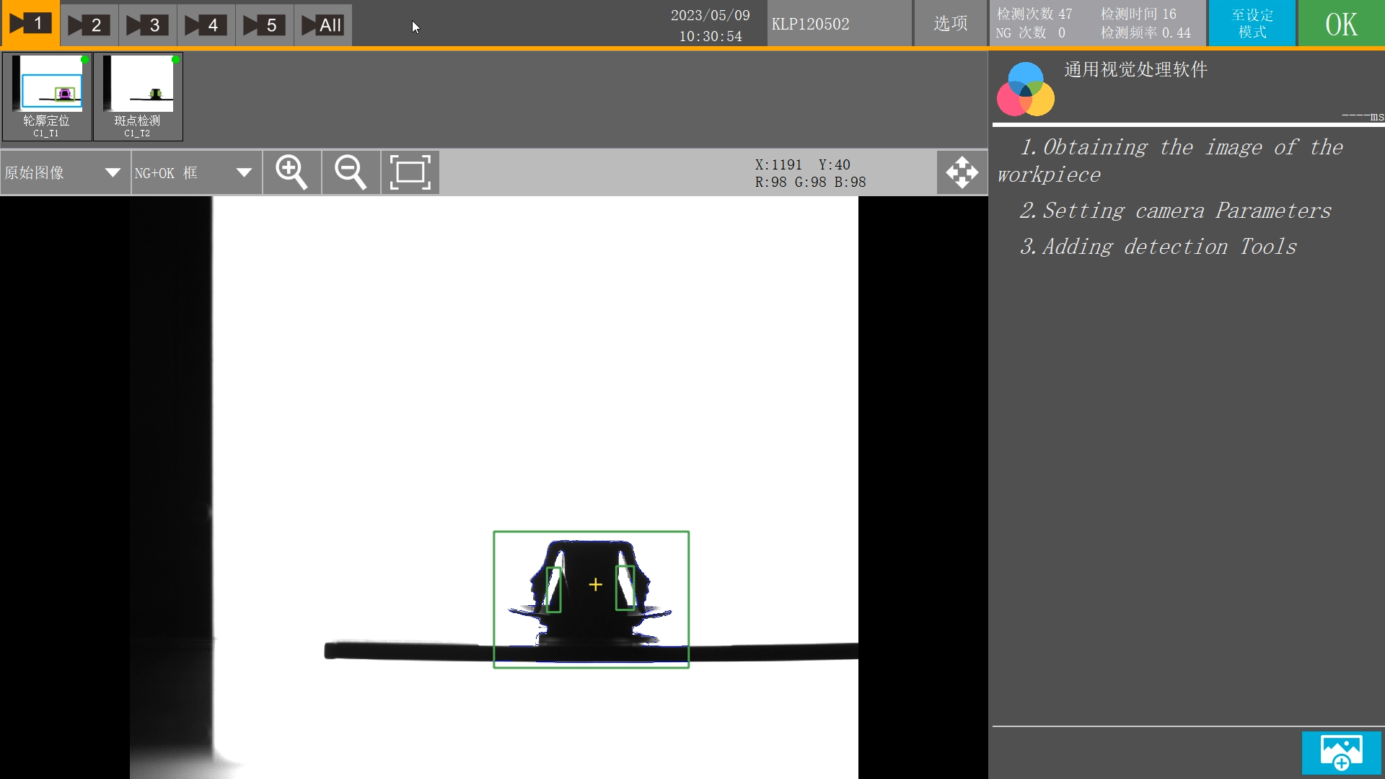
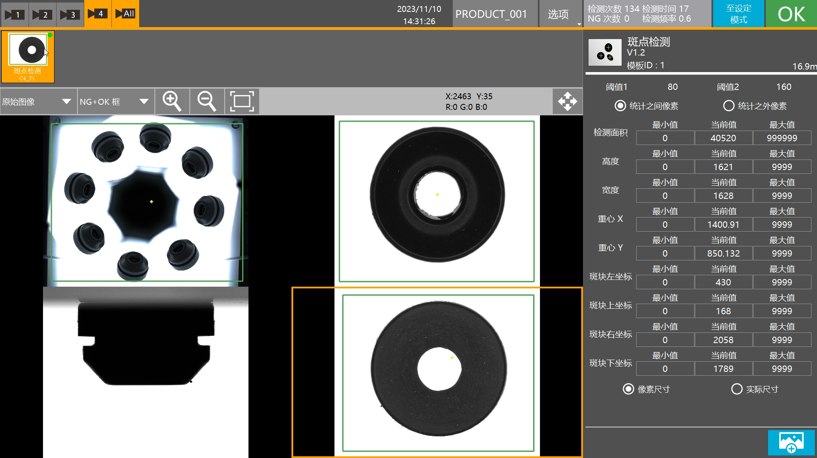
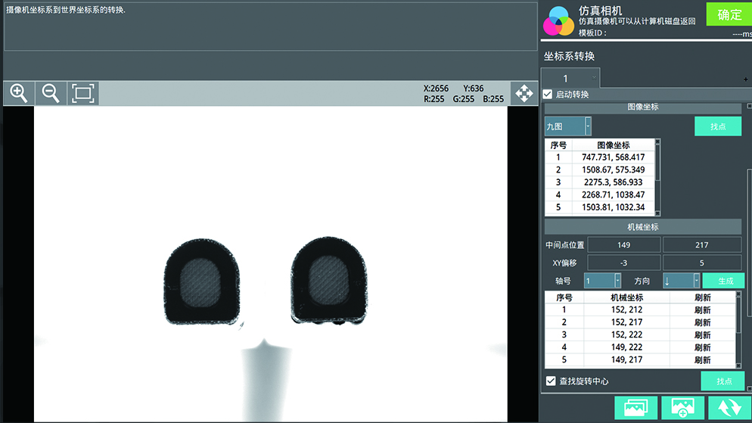
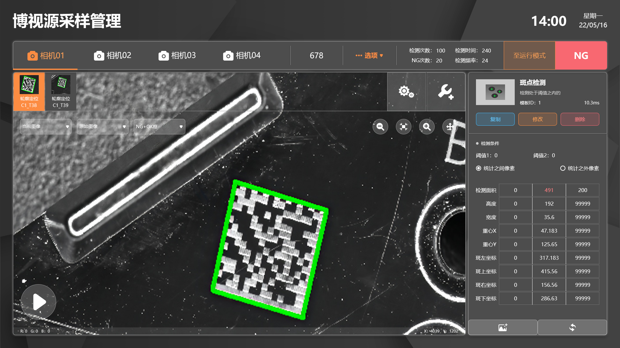
Universal Visual Algorithm Platform
Dimension measurement
Defect detection
The universal visual algorithm platform integrates machine vision functions that have been validated in the market for a long time, such as size measurement, dirt detection, stain/defect detection, and automatic offset positioning. Through programming by C++algorithm engineers, it can be highly matched and applied to multiple non-standard automation devices in our company, achieving four major detection functions including appearance inspection, size measurement, visual positioning, and OCR recognition.
Visual positioning
OCR recognition
Resolve 99% of the testing needs on the market
Interaction between hardware and software
Removal of defective products
Automatically reject non-conforming products when detected
Automatic plate placement
Can be linked with hardware to achieve the effect of automatic disc placement
Automatic packaging
Applied to production lines for automatic packaging of products

Slide 5
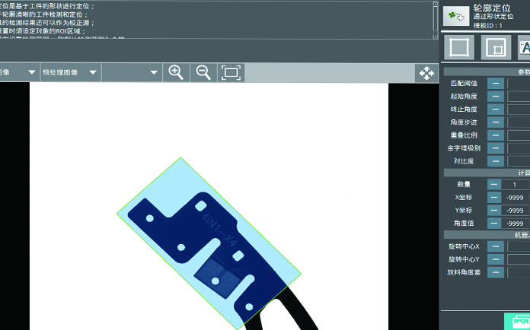
Location function
AI positioning
Circle positioning
Rectangular positioning
Contour positioning
Circle line positioning
Positioning grouping
Location filtering
Insulin Extended Localization
Case Description
Contour positioning
Automatically identify the contour features of products within the detection area, convert them into a format that can be received by the robotic arm, and provide coordinate information for the robotic arm's grasping matching.

Slide 6
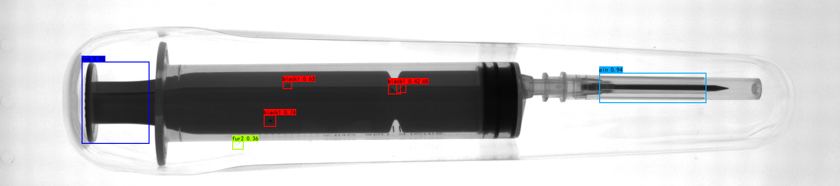
Testing tools
Hair detection
Number of needle tubes
Rubber plug inspection
Scale hair
Number of scales
Positioning grouping
Case Description
Hair detection | Spot detection
Detect hair and dirt with unclear features inside the vacuum formed packaging, and automatically identify and frame their positions.

Slide 7
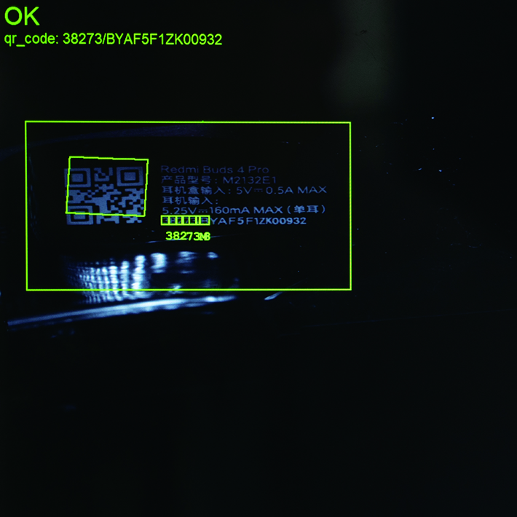
Special identification
QR code
character recognition
Diameter determination
OCR recognition
Case Description
QR code recognition | character recognition
By visual decoding, ensure that the QR code is printed correctly and verify that the clear and dark code contents are consistent.

Slide 8
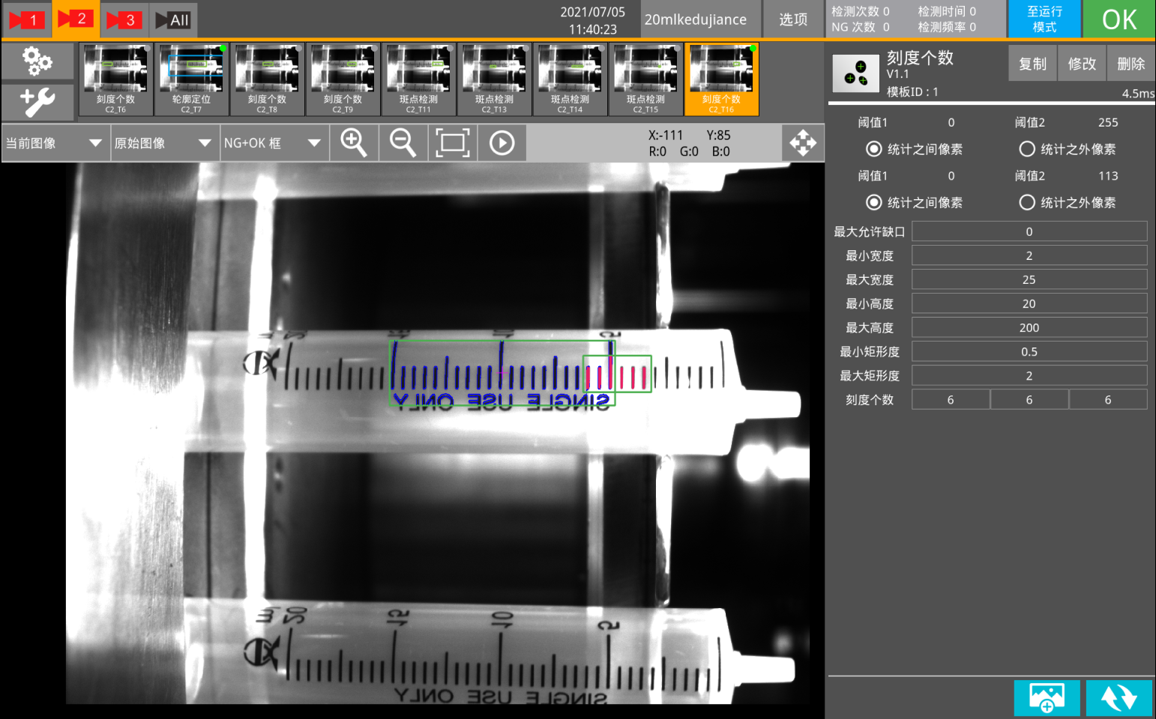
Counting function
Light and dark counting
Spot counting
Edge counting
Case Description
Light and dark counting | Spot counting
By identifying the number of imprints on the syringe, determine whether the test object has defects.

Slide 9
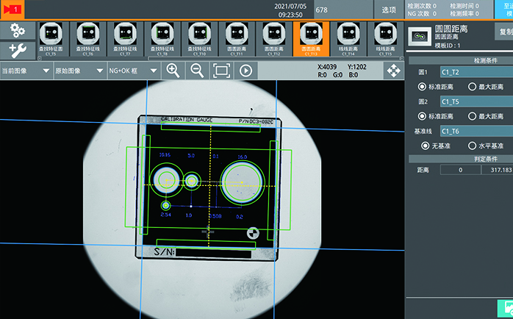
Measurement function
Dot distance
Point line distance
Point circle distance
Line distance
Circle line distance
Case Description
Line distance | Point circle distance
Use measuring tools for the test substance and determine whether it meets the specification requirements based on the measured values.

Slide 10
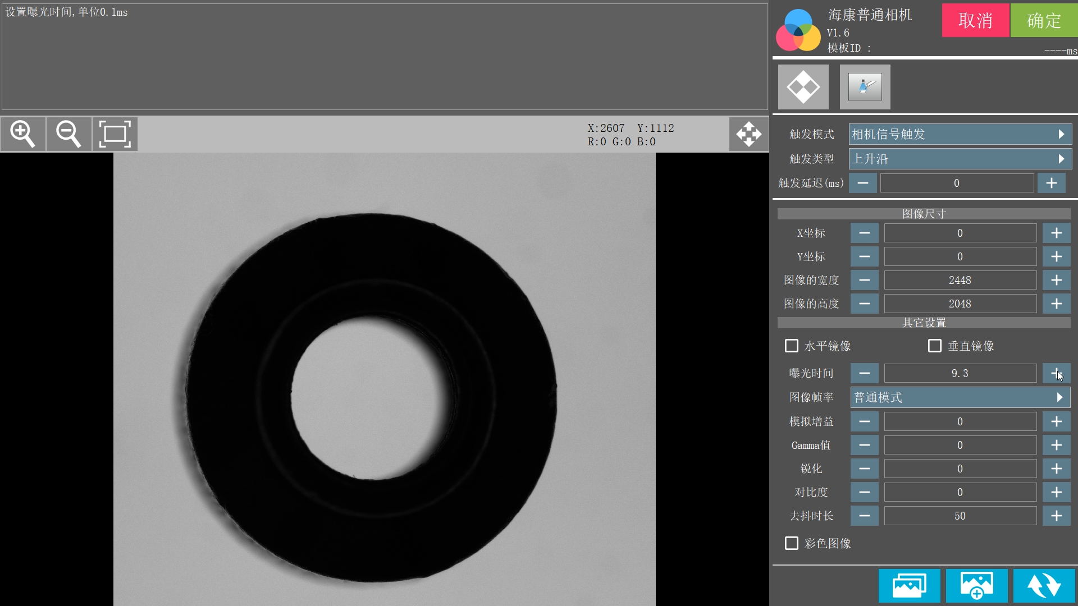


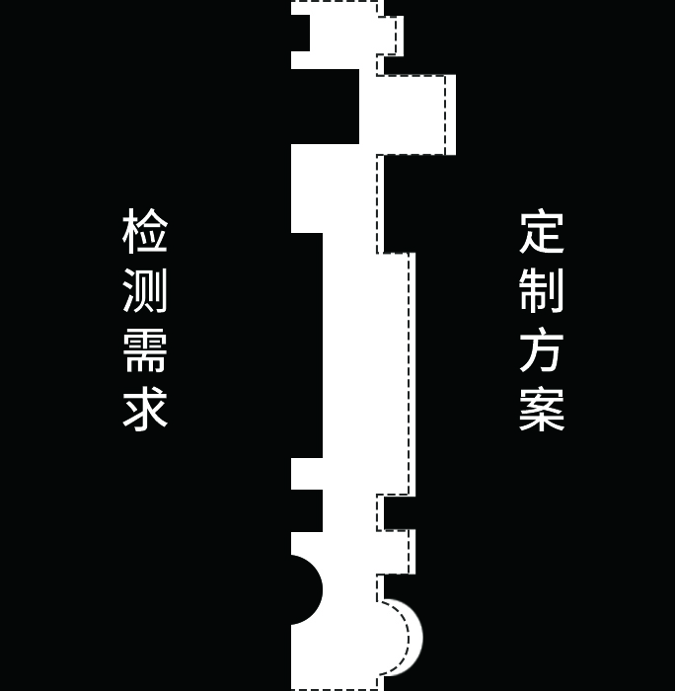
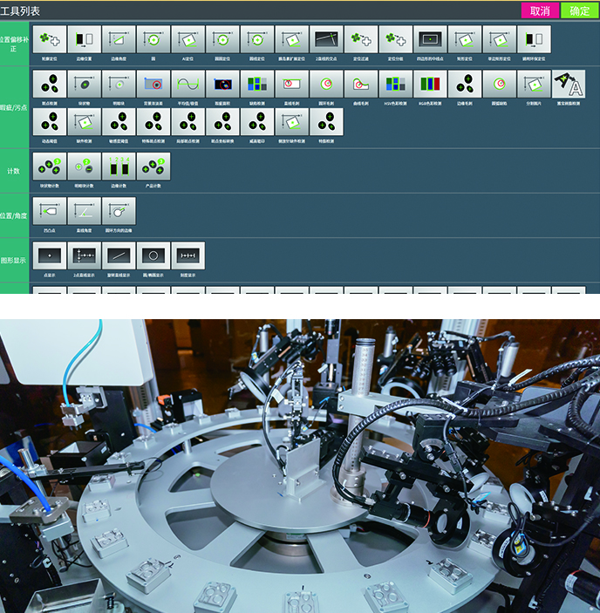
Human computer interaction optimization
Our company's machine vision field achieves software and hardware interoperability by writing code into motion controllers and modifying camera parameters. After version iteration updates, algorithm plugin, and in-depth optimization of UI interface. With the optimization of human-computer interaction, not only does it reduce the learning cost of customers for new software interfaces, but it also significantly shortens the on-site debugging cycle for engineers.
System open source
Our company's machine vision field combines universality and flexibility, and has completely independent intellectual property rights. Can be adapted to customer's on-site equipment systems, such as injection molded parts, robotic arms, etc. Realize cross device interactive operations, improve work efficiency, and reduce communication time costs between engineers and customers.
Software Automation organization
Our company has its own mechanical design department and automation workshop. We have modularized and standardized the mechanism to achieve faster delivery times, more scientific structural design, and more stable quality.

Slide 11


AI algorithm deep learning
Continuously reducing the difficulty of detection
Continuously improve detection accuracy
Continuously improve the recognition accuracy of weak features
Continuously reduce the false detection rate of abnormal features
AI algorithm deep learning, market detection error rate reaches 0.0001%
√
Image dataset
Training model
光学字符识别丨特征识别
Successful training
×
Abnormal false detection
Train again
Abnormal re examination

Slide 12
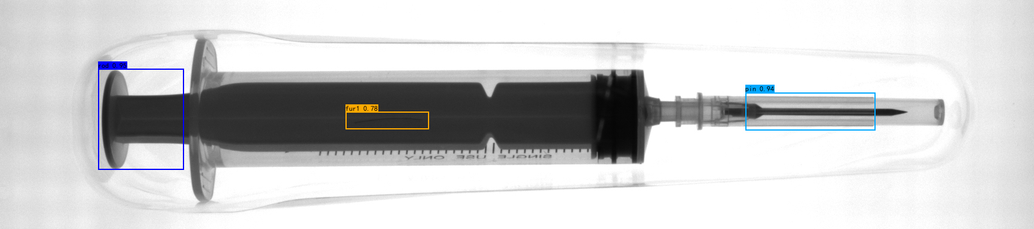
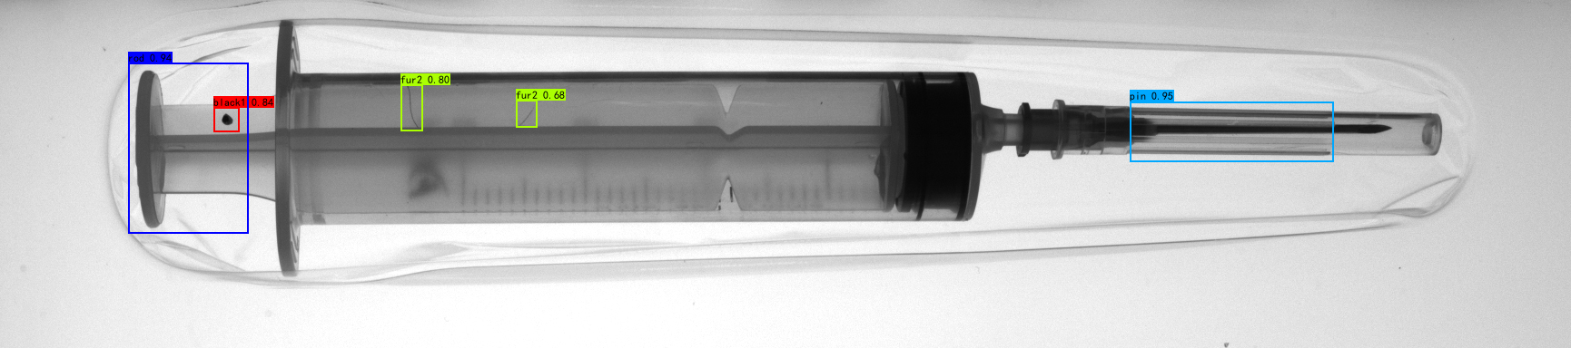
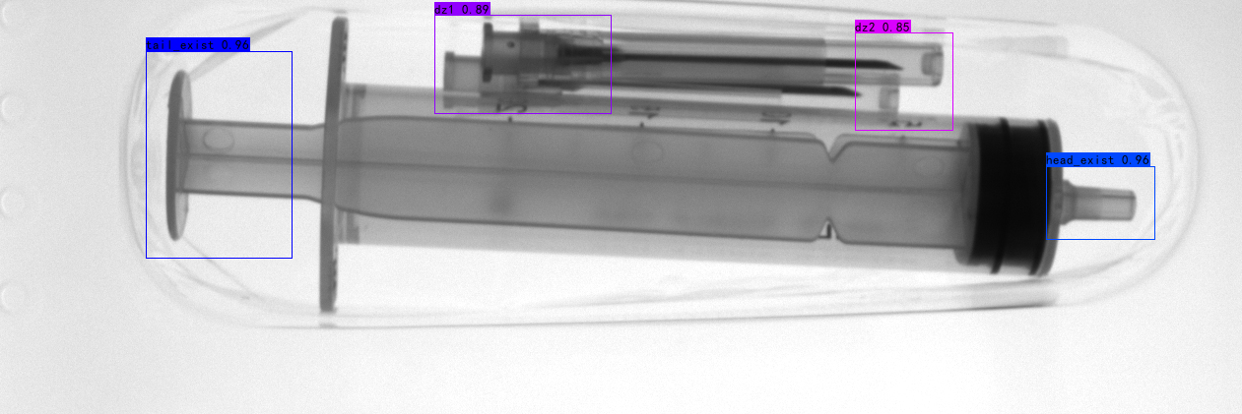
Identification features show weak dirt and foreign objects
AI algorithms can identify weak dirt and foreign objects. Our company has optimized the AI algorithm by repeatedly training on identifying weak features in abnormal false detections, and strengthening the ability to recognize dirt and foreign objects with weak features in dark areas.
More accurate detection results
AI algorithms can detect hair and foreign object spots in general situations. Our company has strengthened the AI algorithm structure to enhance the detection of subtle features such as hair, foreign objects, and spots, significantly reducing false detection rates and improving enterprise productivity.
Accurate recognition, can detect any placed object
Our company has strengthened the positioning assistance correction function in AI algorithms, which can automatically and accurately identify and detect objects when placing them arbitrarily, reducing the rate of missed detections.

Slide 13






Resolve high development time and cost
Resolve multiple system vulnerabilities
Integrated visual algorithm library, diverse software functions, low development time and cost
Can be combined with AI algorithms to learn various types of false positive samples and continuously reduce them
Low false alarm rate
Resolve the problem of low detection accuracy and easy false detection
Resolve version fragmentation
Unified software version, applicable to 90% of visual inspection needs on the market
Can be combined with AI algorithms to learn various types of false positive samples and continuously reduce false positive rates
Resolve inconsistent operation methods
Resolve the requirement for professional personnel to set up testing engineering
Summarize user operating habits and make the operation more user-friendly
The operation interface is decentralized and simplified, allowing users to set and modify visual inspection schemes on their own

Slide 14
Reasonable application of algorithms
part 3

Slide 15
Fuzzy processing, Canny, closed operation, contrast, erosion, interference control, median filtering, grayscale stretching, Gaussian filtering, open operation, binarization, brightness correction, line defect extraction, speckle filtering, local thresholding, ROBERTS, PREWITT, etc. belong to median filtering, while Gaussian filtering belongs to low-pass filtering. The edges, jumping parts, and granular noise of an image represent the high-frequency components of the image signal, while the large background area represents the low-frequency signal of the image signal. Filtering out its high-frequency parts can remove the noise.
Binarization
Setting the grayscale values of pixels in the image to 0 or 255 results in a visual effect of only black and white in the entire image.
Open operation
Corrosion followed by expansion can eliminate small white spots (noise) outside the image area.
Canny edge algorithm
The edge detection algorithm significantly reduces the data size of the image while retaining the original image attributes.
Closing Operation
Expanding first and then corroding can eliminate small black spots (noise) in the image area.
Gray scale stretching
Also known as contrast stretching, it is the most basic type of grayscale transformation that uses the simplest piecewise linear transformation function. Its main idea is to improve the dynamic range of grayscale levels during image processing.
Roberts operator
The processing effect is better for images with steep and low noise. From the actual effect of image processing, the calculation is simple and the edge localization is accurate.

Slide 16
Reasonable application of AI algorithms
part 4

Slide 17
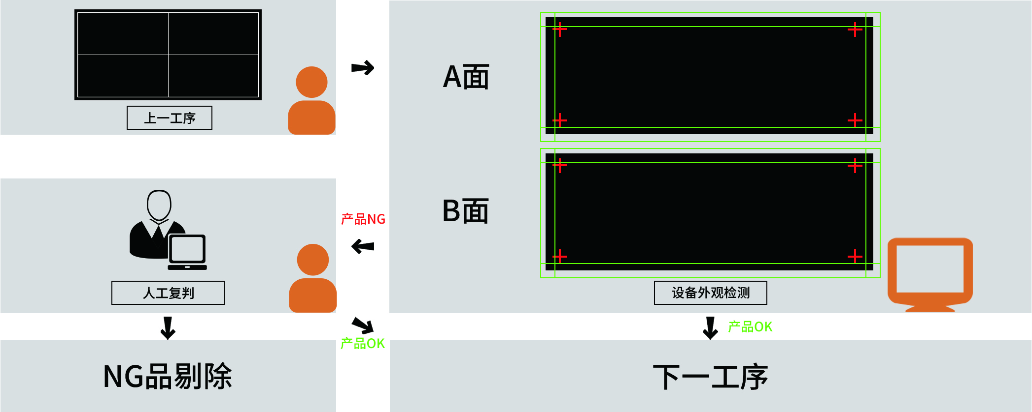
Border patrol detection system
The edge detection system is a customized program for display screen detection, which serves line scan cameras for non planar imaging. The data end uses mature detection algorithms from the general visual algorithm platform to achieve precise detection of high-precision linear images.
Border patrol management software
Border patrol detection software

Slide 18
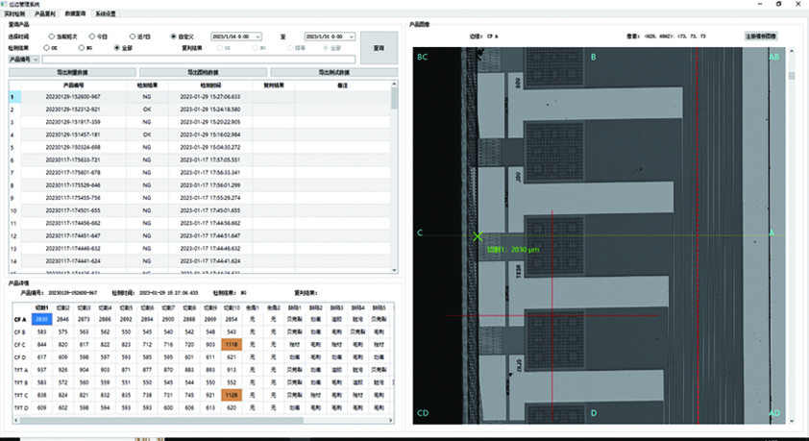
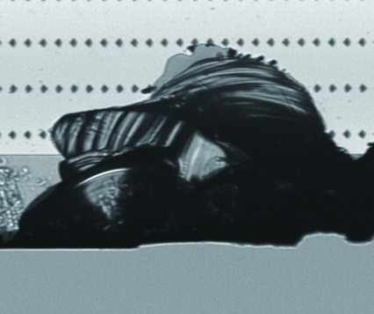
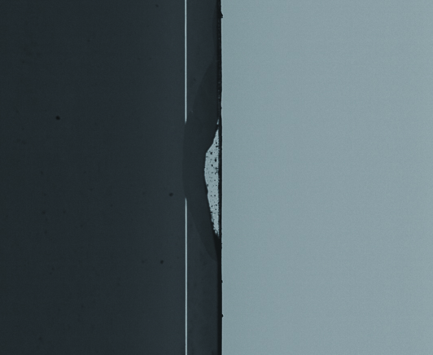

The detection software is responsible for the appearance measurement and defect detection of each edge of the display panel.
Partial testing requirements
Appearance edge measurement
Shell crack
Peripheral fault
Minor scratches

Slide 19
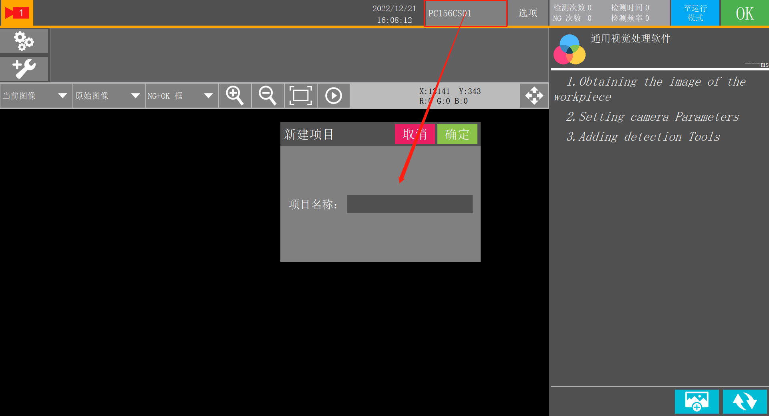
Core advantages
Using universal visual algorithms to detect embedded AI deep learning
The system will crop and classify linear high pixel images, which can perfectly match our company's mature detection algorithms.
By embedding AI deep learning into the algorithm and accumulating learning from continuously generated cases, the detection accuracy will continue to improve.
1
2
3
Mark positioning
Support precise positioning of
cross mark marks of specified size.
Appearance Measurement
Support measurement of cutting
accuracy and chamfering accuracy.
Viewing historical product data
Filter and query the testing data of specified products based on production date, time period, product number, and testing results, and support exporting product drawing data.

Slide 20
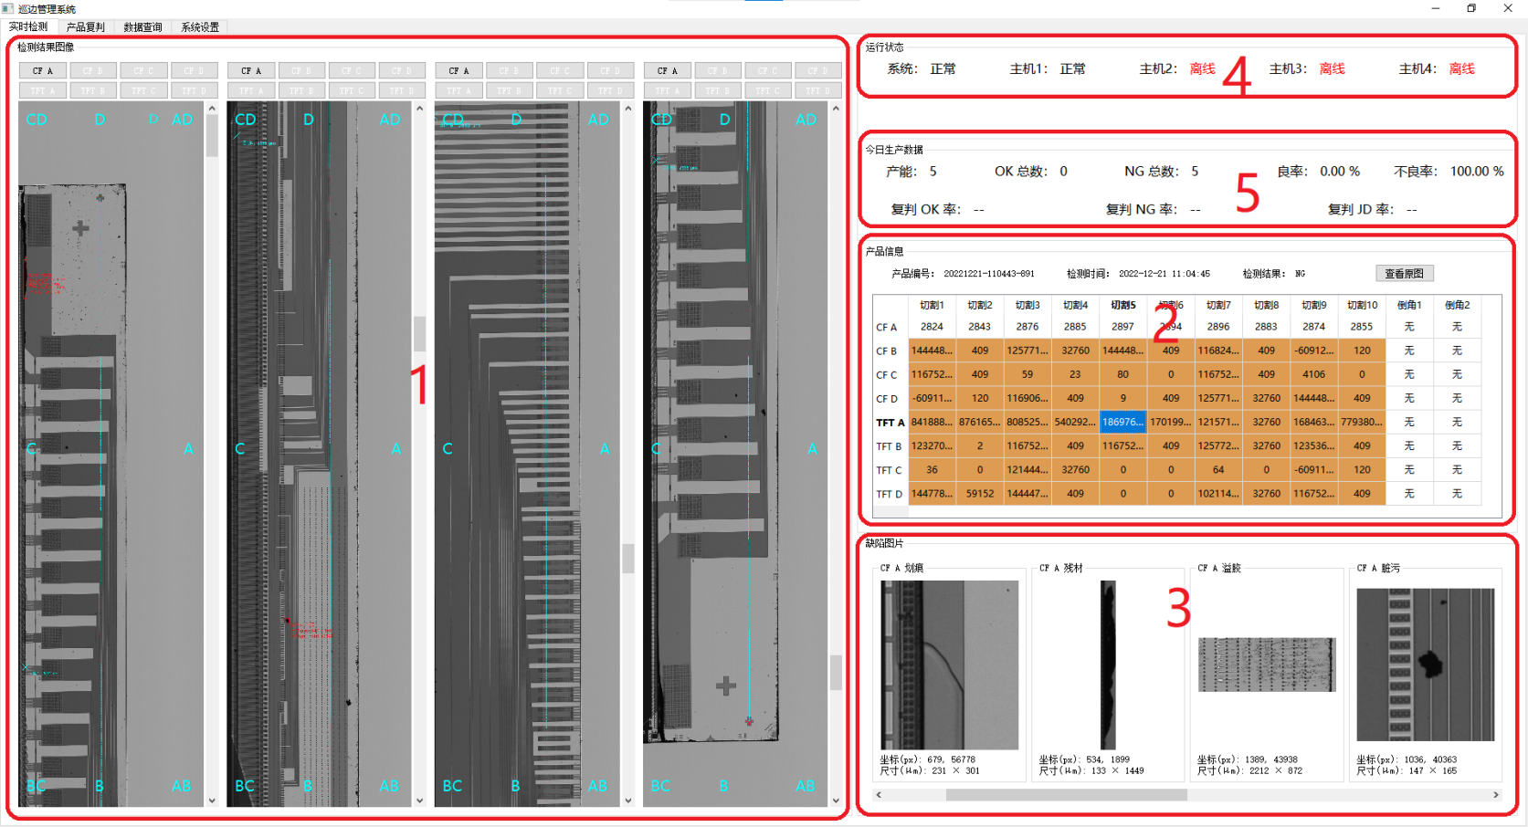
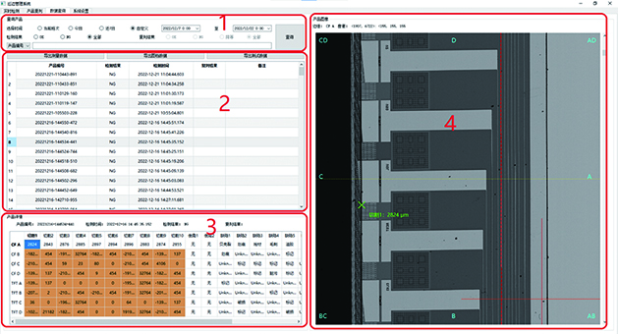
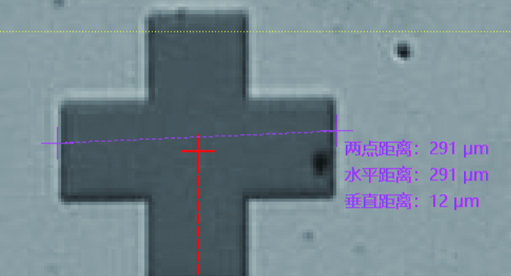
The management software is responsible for real-time integration of the results of various detection software, re evaluation of NG products, and data management.
Real time monitoring and management
Data query management
Manual distance measurement

Slide 21
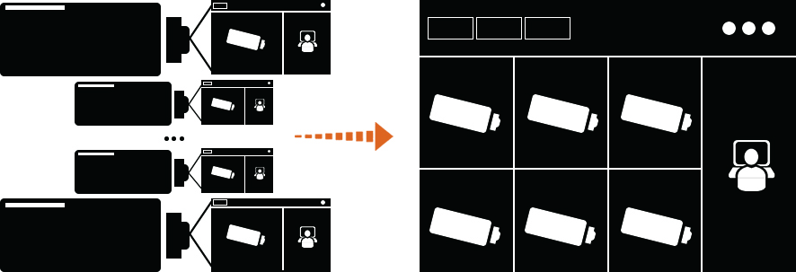
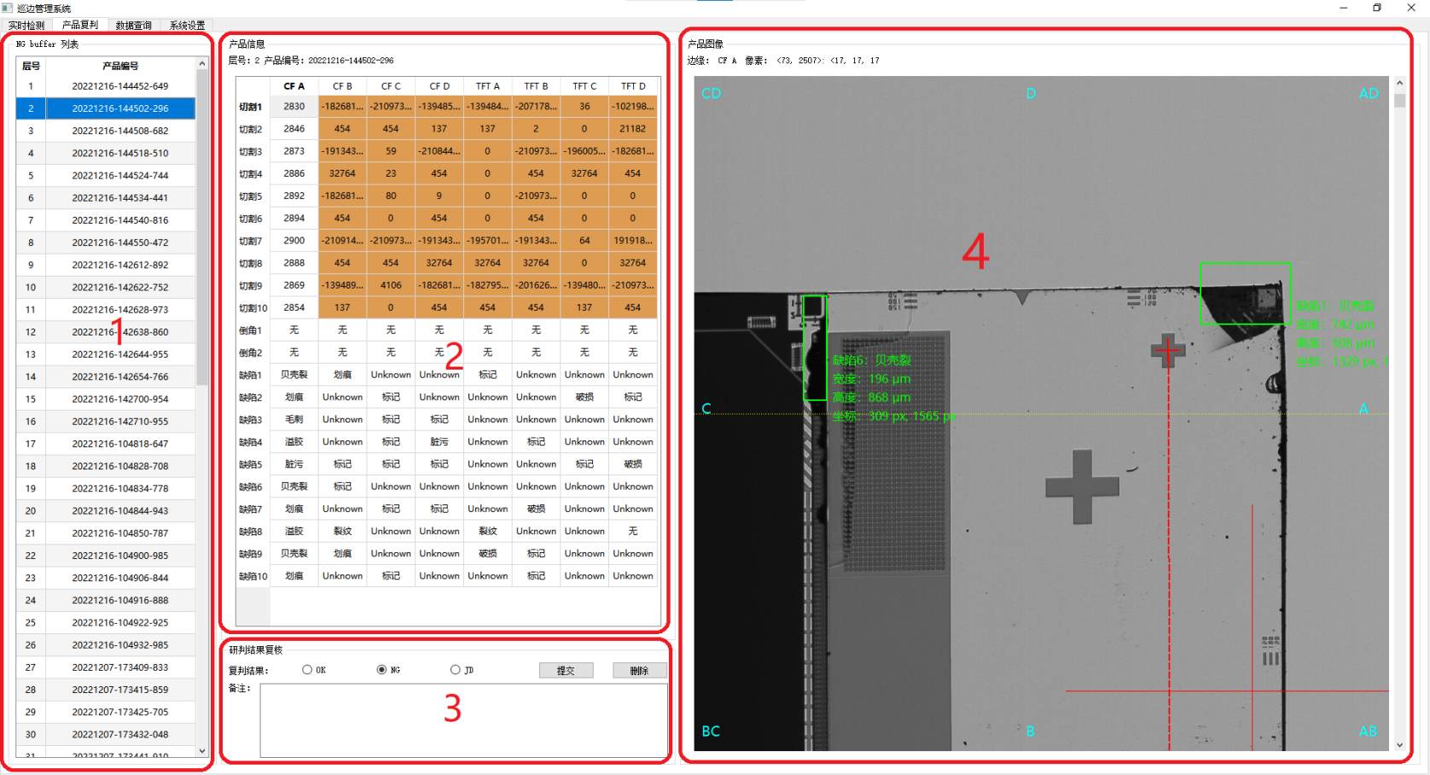
Core advantages
Multi host bridging, integrating multi-party data for unified computing and port management
For products judged as NG by the system, manual viewing and measurement of product original images are supported, followed by manual review and submission of re evaluation results.

Slide 22
Other functions
Real time detection data viewing: Real time display of current product detection result images, cutting and chamfering measurement data, and defect small images.
Viewing historical product data: Filter and query the testing data of specified products based on production date, time period, product number, and testing results, and support exporting product drawing data.
Data statistics: statistics on daily production capacity and re evaluation results.
Data reporting: Production data reporting to DFS and CIM systems.
System configuration: Configure measurement specifications and upper and lower limit parameters.
System status management: Manage the operating status of the system, detection software, cameras, and PLC, and issue fault and abnormal alarms.

Slide 23
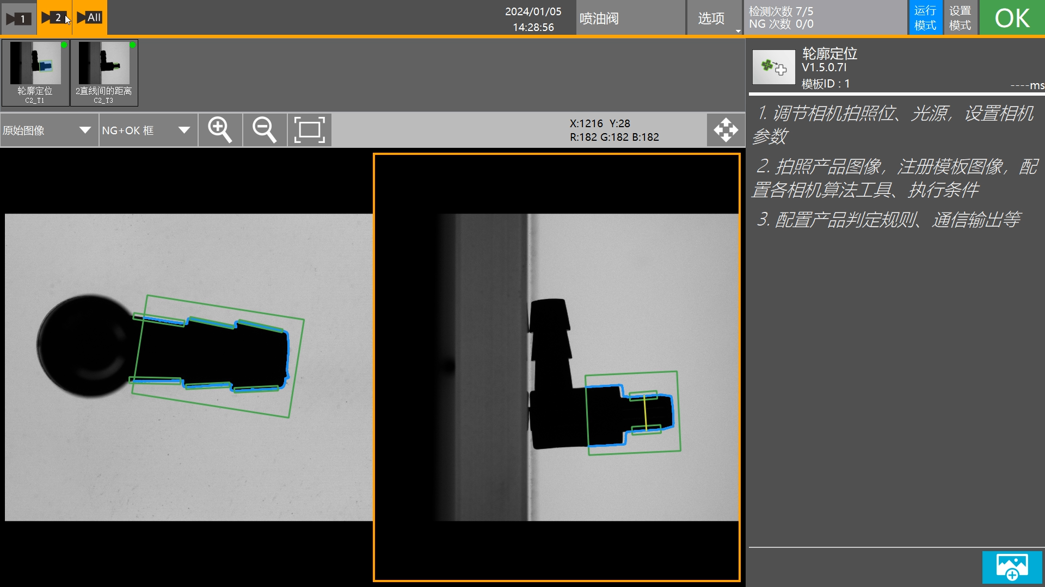
Software introduction
The operation interface is decentralized and simplified, with open user permissions, allowing customers to set and modify projects on their own.
The visual module mechanism is connected with software to achieve visual debugging on the system.
System networking allows engineers to remotely debug devices.
Online training of AI models.
The software has high compatibility with multiple types of products, and users can quickly switch between testing materials through sample management.

Slide 24
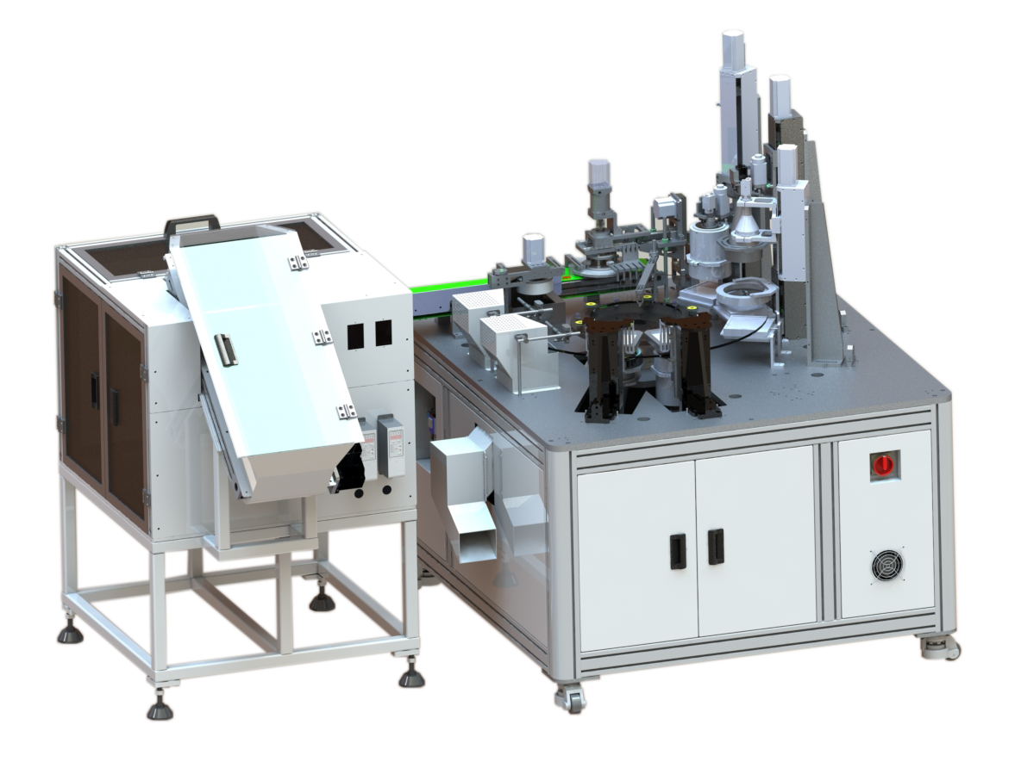
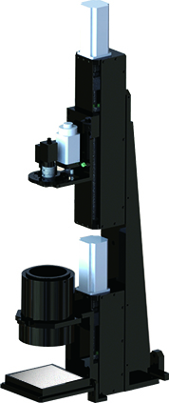
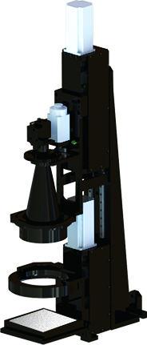
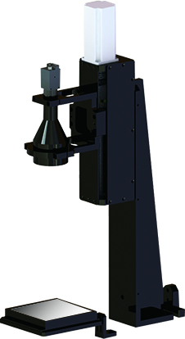
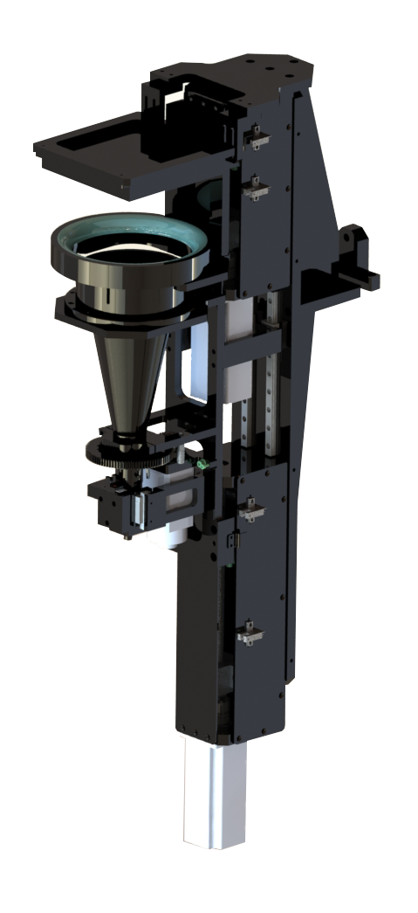
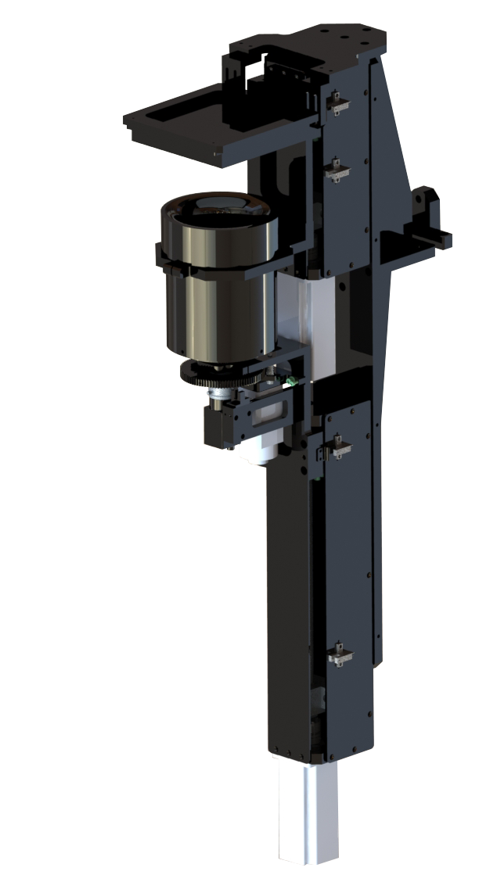
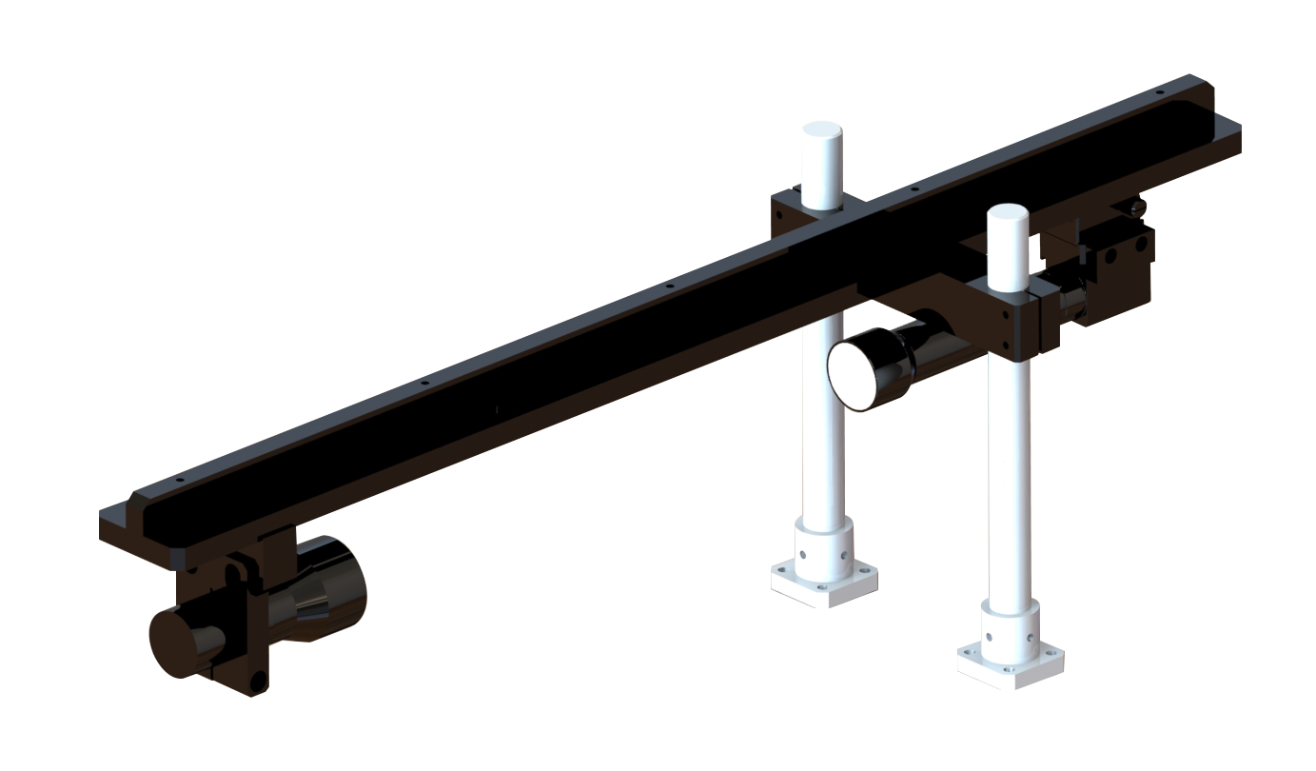
Structural characteristics of turntable machine
Due to the transparency principle of its material, it can achieve full coverage of the appearance of all six surfaces of the product captured by the area array camera without blind spots.
Camera setup module

Slide 25
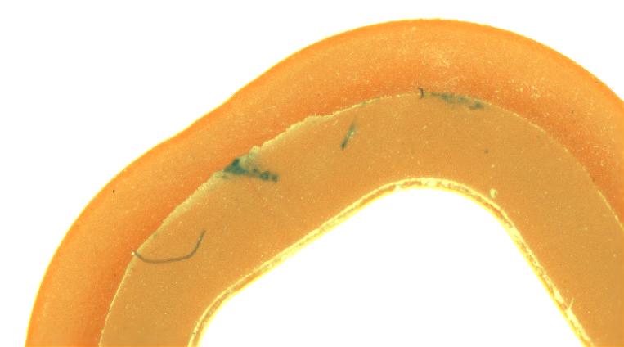
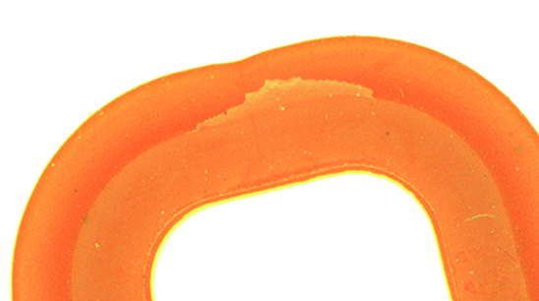
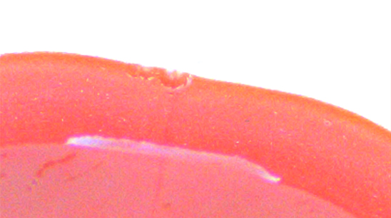
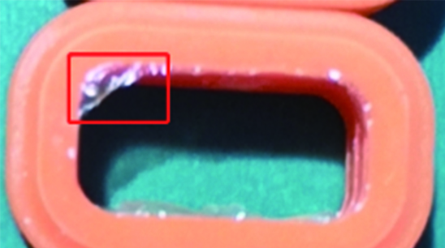
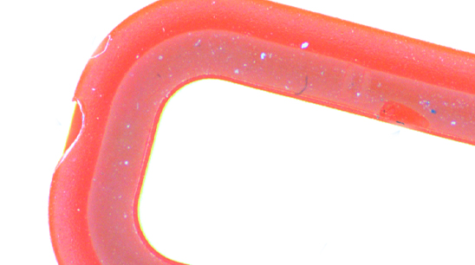
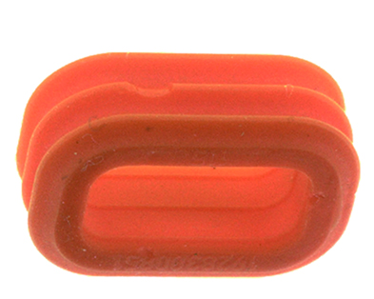
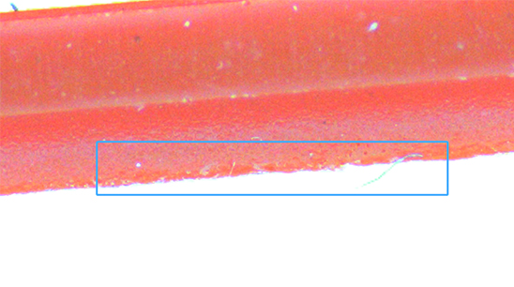

Case application
Liquid silicone testing machine
Defect type: dirt and stains
Defect type: Exhaust port burrs
Defect type: concave rib
Defect type: Inner ring burrs
Defect type: Front notch
Defect type: Side notch
Defect type: edge pitting
Defect type: Dimensional inspection

Slide 26
Cooperative clients
Our company uses continuously innovative technological achievements to help customers in various industries open up the era of Industry 4.0. 12 years of trust, jointly ushering in a new era of industrial manufacturing in China.
part 6

Slide 27



















Slide 28
谢谢观看！
Thanks You！

