Slide 1
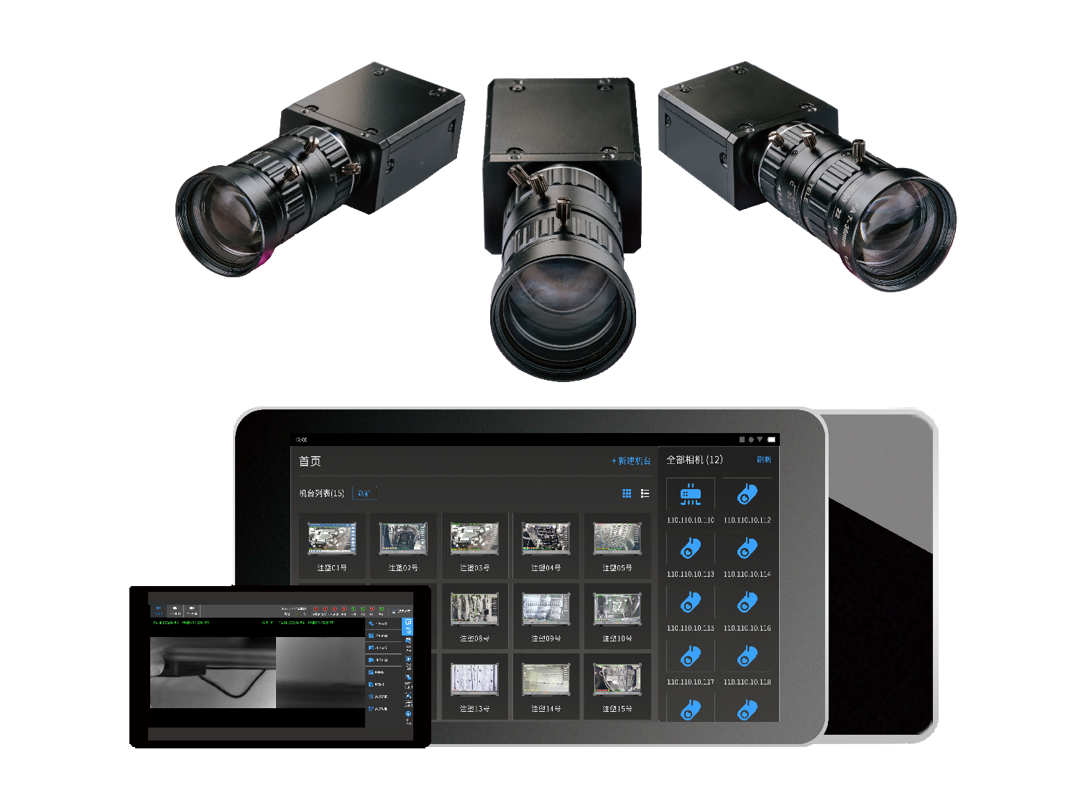
Intelligent mold monitor
Terminator of Traditional Mold Monitor | Fifth Generation Intelligent Mold Monitor

Slide 2
Application scenarios
Product Upgrading
Application area
Configuration

Slide 3
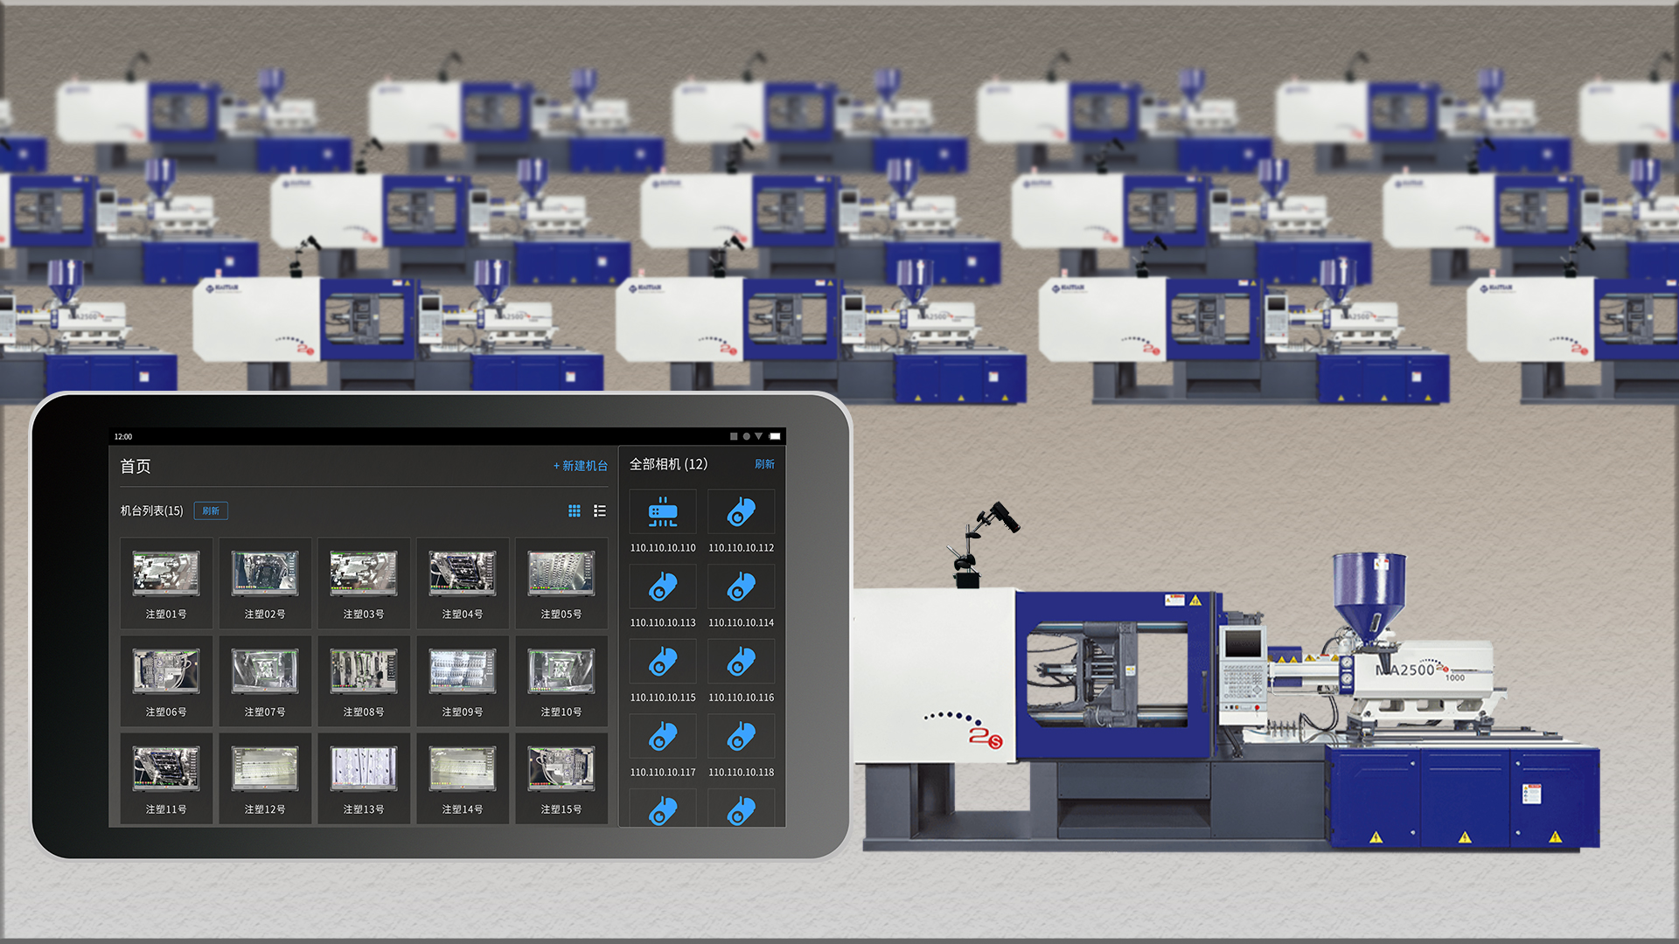
1.Application scenarios

Slide 4
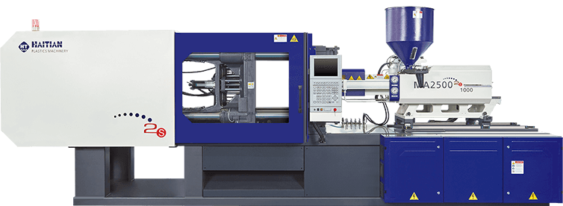
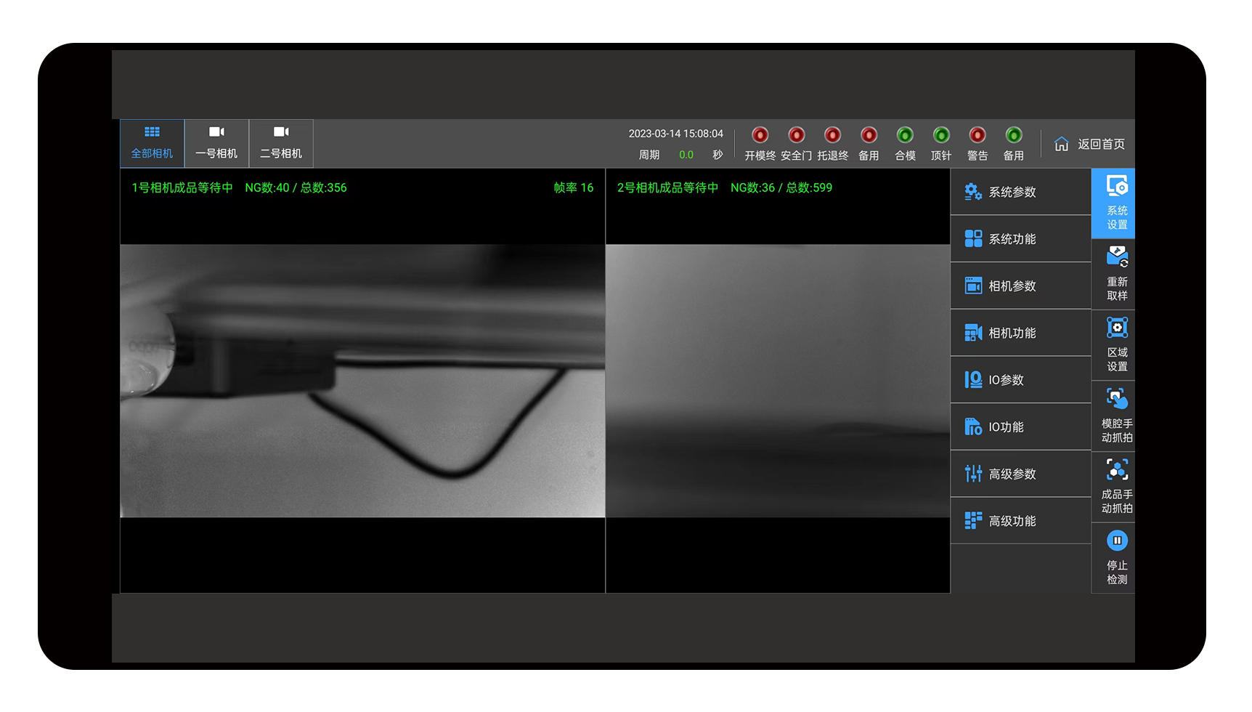
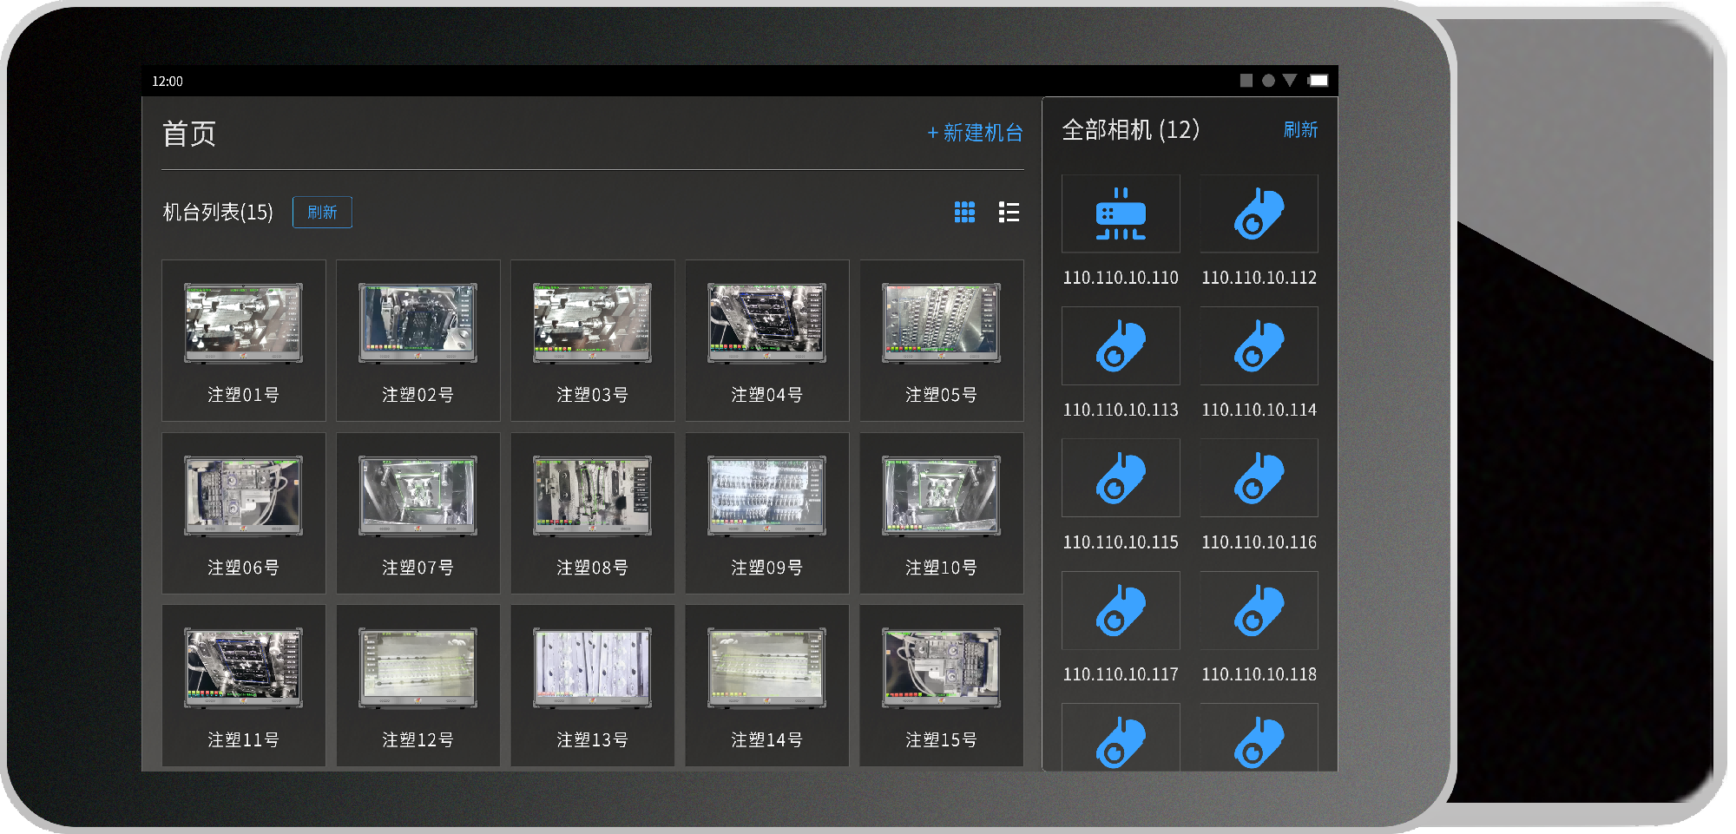
2.Product Upgrade - Hardware Cost
 | Third generation mold monitor | The fifth generation intelligent mold monitor
Hardware cost | One injection molding machine is matched with a set of screen mounted hosts. Purchase multiple units, with a hardware cost of 1 * N | No host, no screen design, procurement cost is 80% of the old model Dozens of terminal devices share a mobile terminal (optional tablet/phone) for display and control
Terminal*∞

Slide 5

2.Product Upgrade - Labor Costs
 | Third generation mold monitor | The fifth generation intelligent mold monitor
Labor cost | Mold monitoring and control require dedicated personnel to be on duty, and each person can supervise ≤ 5 devices | Real time upload of monitoring data, one person can monitor N detection stations, significantly reducing labor costs
Operation workstation*N

Slide 6

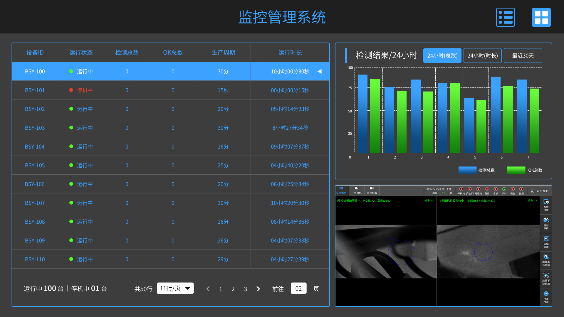




2.Product Upgrade - Establish MES System
Establish MES system | Third generation mold monitor | The fifth generation intelligent mold monitor
 | Unable to create and connect to Mes system | Based on wired network layout, the workshop terminal is connected, and real-time monitoring data of the injection molding machine is collected through the fourth generation mold monitor. Real time production data and historical statistical data can be projected to the workshop data dashboard and the office of the company management, achieving the establishment of the MES system in the production workshop and upgrading the intelligent workshop.
Wired layout
Wireless transmission
Corporate network
user terminal
Workshop Data Dashboard
Management Office
Match quantity switch
......
Workshop router
Operating workstation tablet wireless monitoring

Slide 7

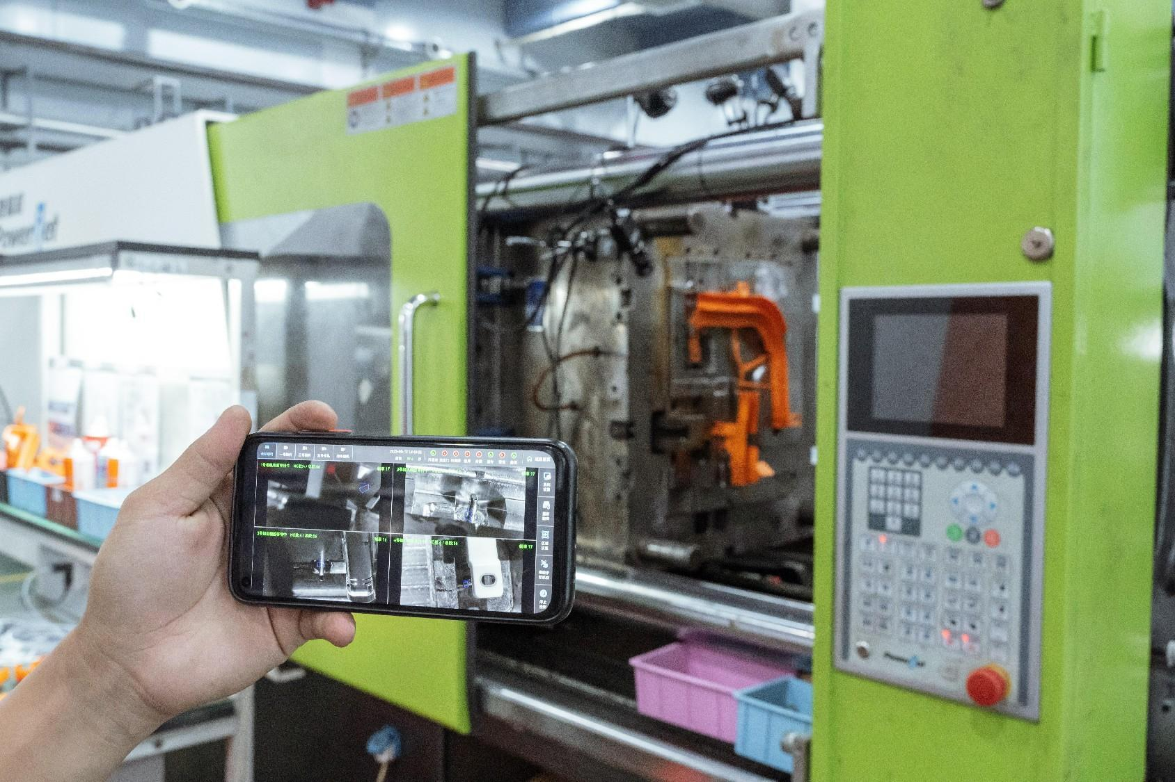
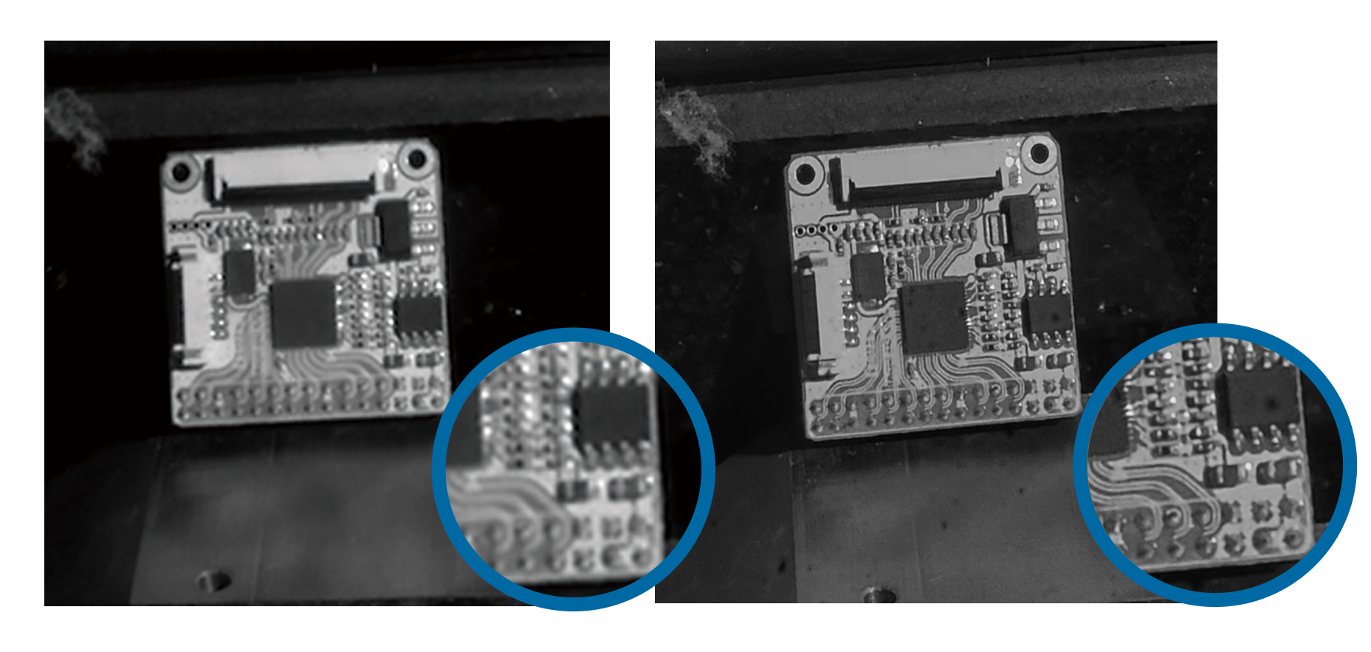
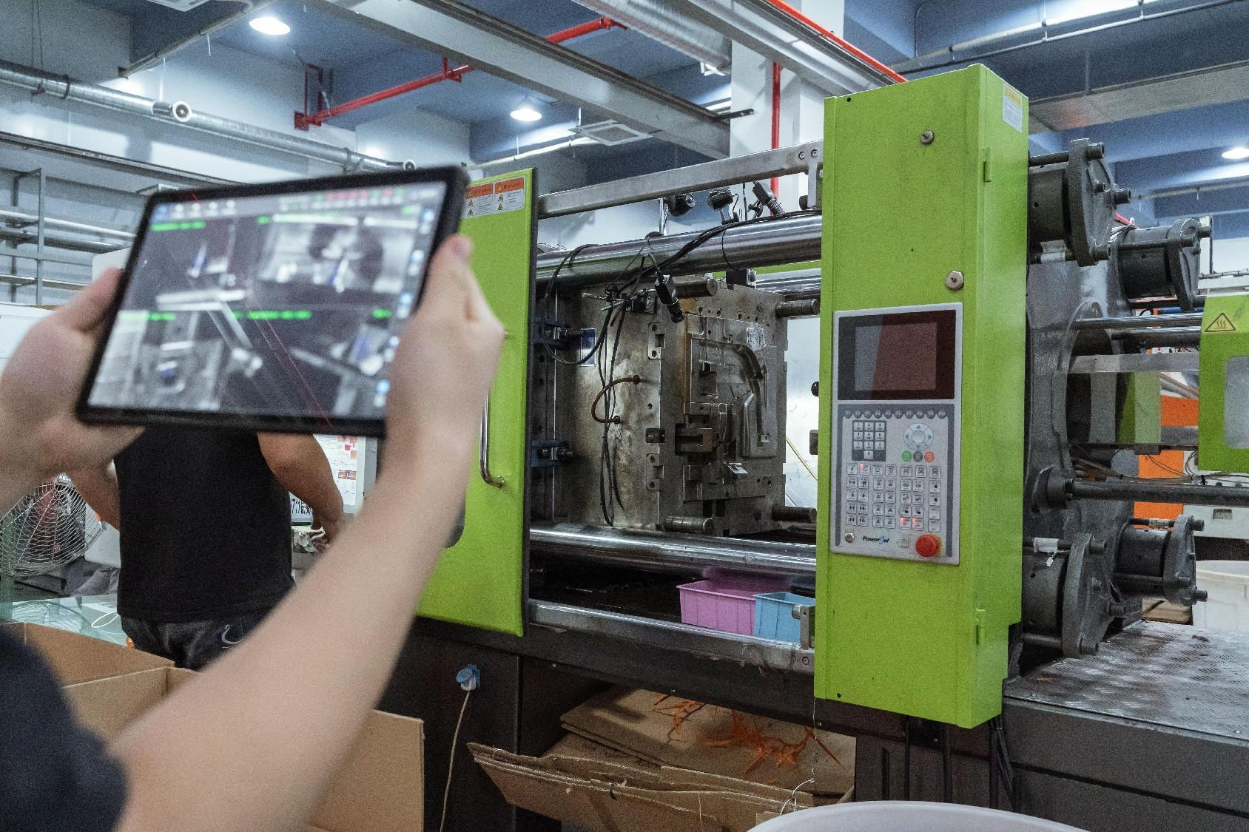
2.Product Upgrade - Production Efficiency
 | Third generation mold monitor | The fifth generation intelligent mold monitor
Debugging and upgrading methods | Program issues and system upgrades require engineers to handle them on the machine, which has latency | Online background debugging and online upgrade can be realized by connecting to the Internet
Imaging effect | Traditional industrial cameras have poor imaging clarity in specific low light environments, making them more prone to misjudging alarms | Using self-developed cameras, the imaging resolution is further improved, effectively reducing the misjudgment rate
Convenience of operation | The operating end needs to be wired and fixed next to the mold. In case of mold abnormalities, the staff need to monitor and handle them at the terminal | The operating end is a wireless tablet/phone, and wireless mold monitoring and terminal operation can be performed through a mobile app within the local area network

Slide 8
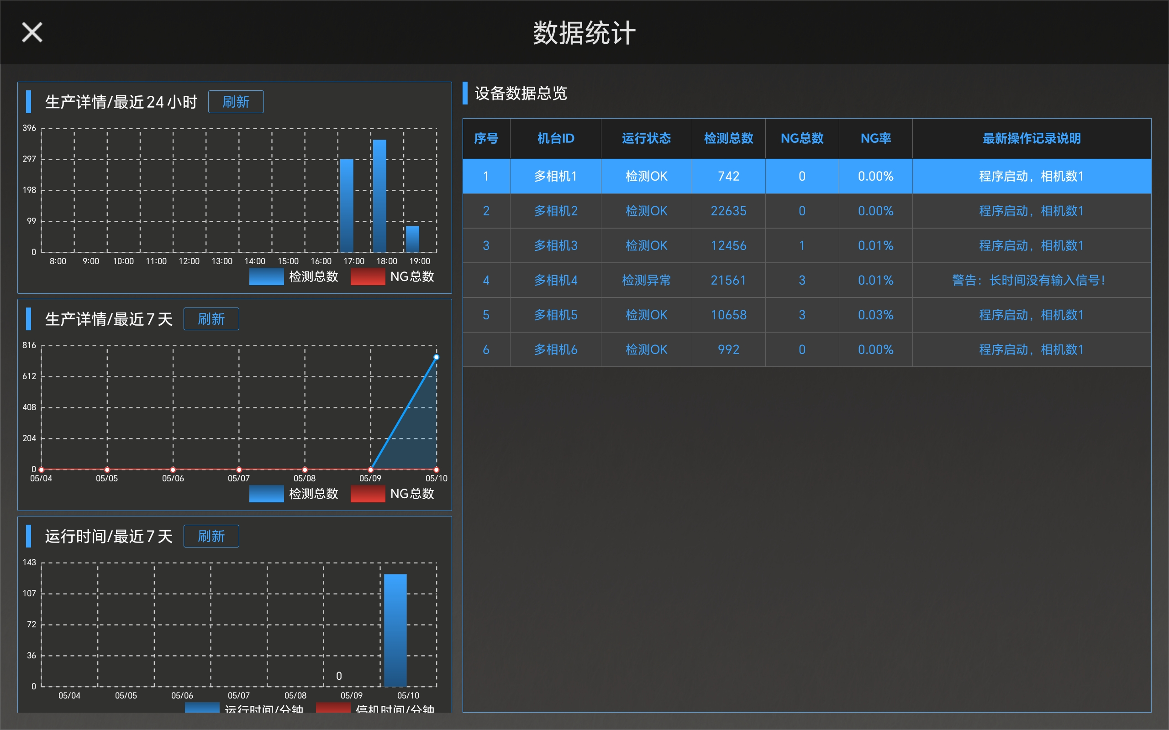
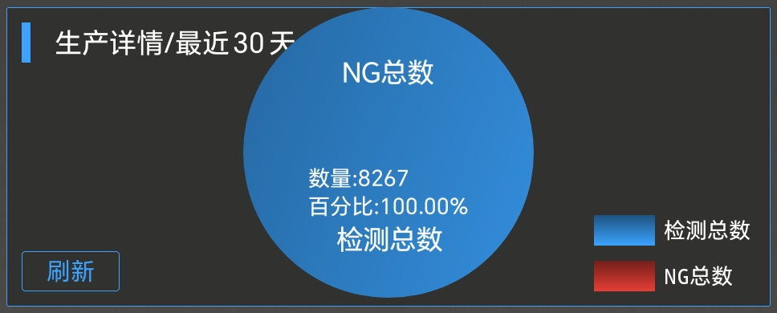
2.Product Upgrade - Data Management
 | Third generation mold monitor | The fifth generation intelligent mold monitor
Data management | No detailed data statistical function | Real time data upload, data visualization and visualization, creating a more intuitive new way of digital collaborative management

Slide 9
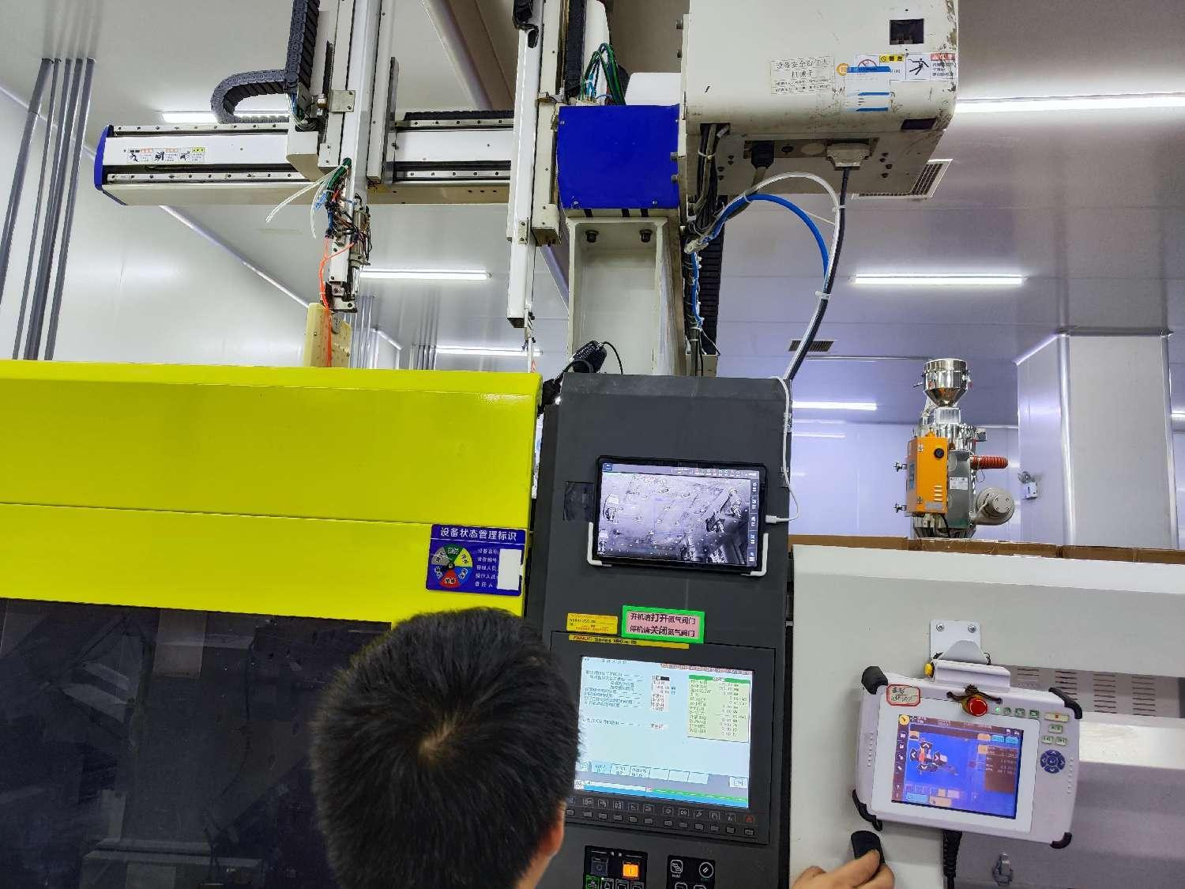
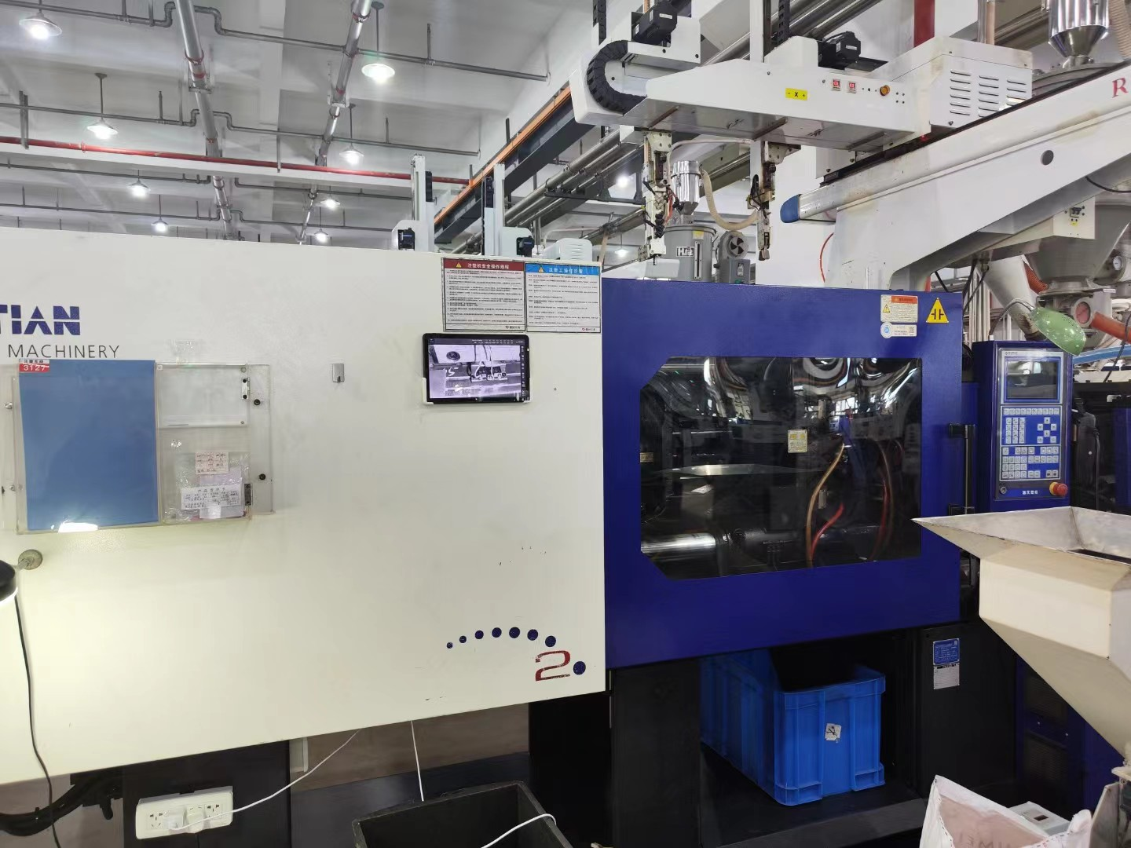
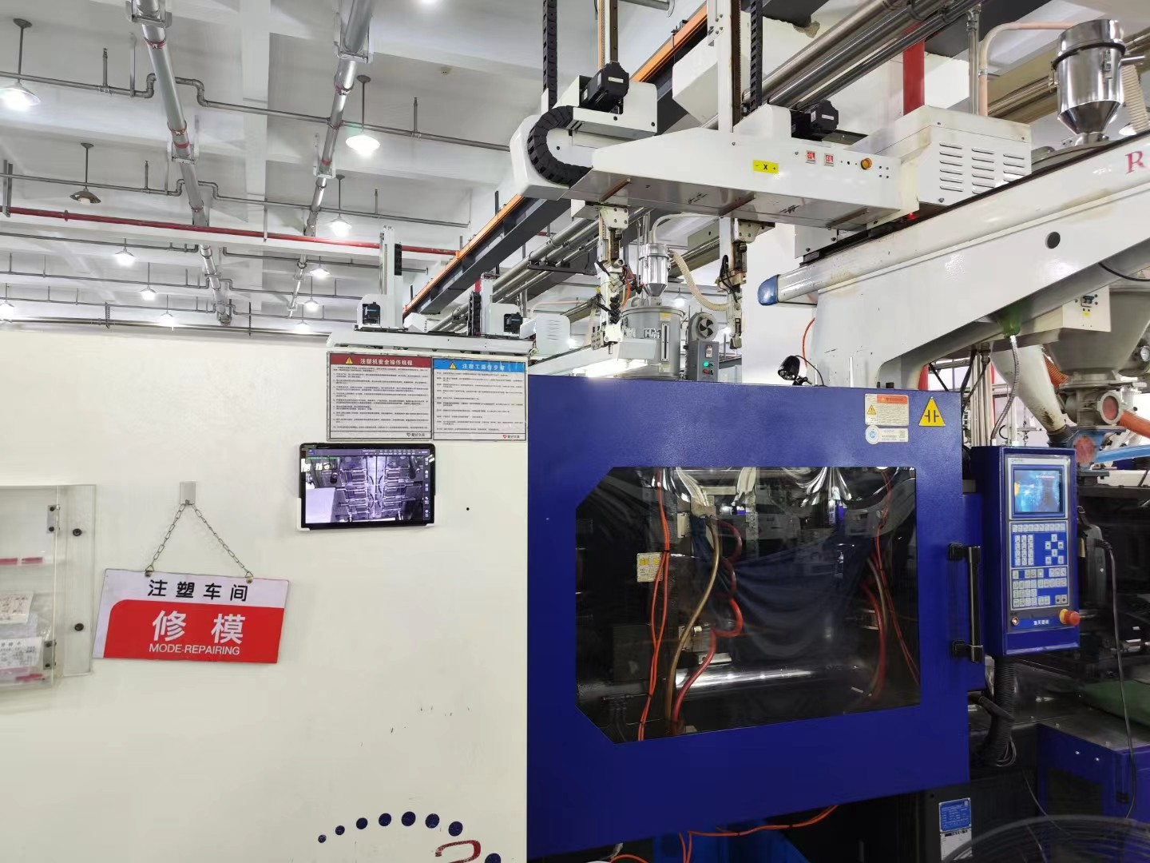
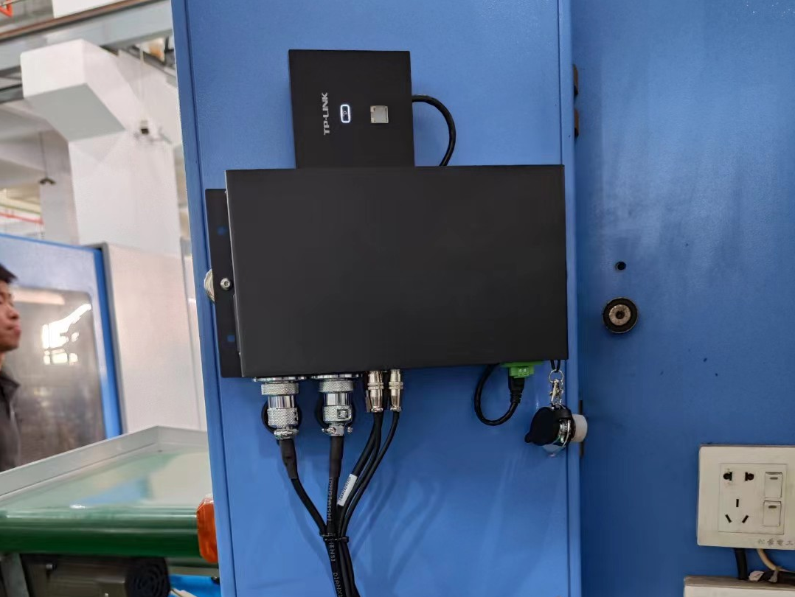
3.Application area
Technology
Injection molding process
Stamping
Die casting process
Industry
Auto Parts
3C Electronics
Home appliance accessories
Medical Instrument
Data collection
Production yield rate
Single machine production efficiency
Multi machine monitoring
Data upload
Industry 4.0
Annual sales of 3000+

Slide 10
4.Configuration
Fifth generation model maintenance configuration list | Brand | Specifications | Unit
Ipad | Lenovo/Honor (optional) | 10.1 inches | unit
AP panel/router | TP-LINK(Optional) | kilomega | unit
IO power communication box | self Customization | PA-1017(4+1) | unit
IO communication cable | self Customization | IL-1240 | unit
IO communication box power cord | self Customization | PL-302 | unit
Smart camera | self Customization | BC-432 | unit
High flexibility Ethernet cable | self Customization | Super five categories | unit
Industrial lens | self Customization | BLE-801 | unit
Magnetic Seat Set | self Customization | MB-905 | unit
Infrared light source | self Customization | BL-210I | unit
Infrared light source power cord | self Customization | PL-L02 | unit
electric relay | Omron | MY2N（Equipped with a base) | unit
Instructions | self Customization | Paper printing | unit
Hardware parameters of the fifth generation mold monitor
CPU | ARM chip
Screen resolution | 1920*1080
Frame rate | 30FPS frame rate
Footage | Wide angle end - medium focus end (12-36mm) lens
Sensor | Stacked CMOS sensor
Available tablet hardware parameters (example)
CPU | Tianji 8100
Resolution | 2560*1600
Screen size | 12.1 inches
System | Magic OS 7.0
Battery capacity | 10050mAh (typical value)

Slide 11
Thanks You！

