Slide 1


VISION
INSPECTION
Mold-monitor

Slide 2
1
Product Introduction
2
Core advantages
3
Configuration parameter
CONTENTS
4
Big Data Management System
5
Thermal imaging mold monitor
6
Other functions
7
Application area

Slide 3
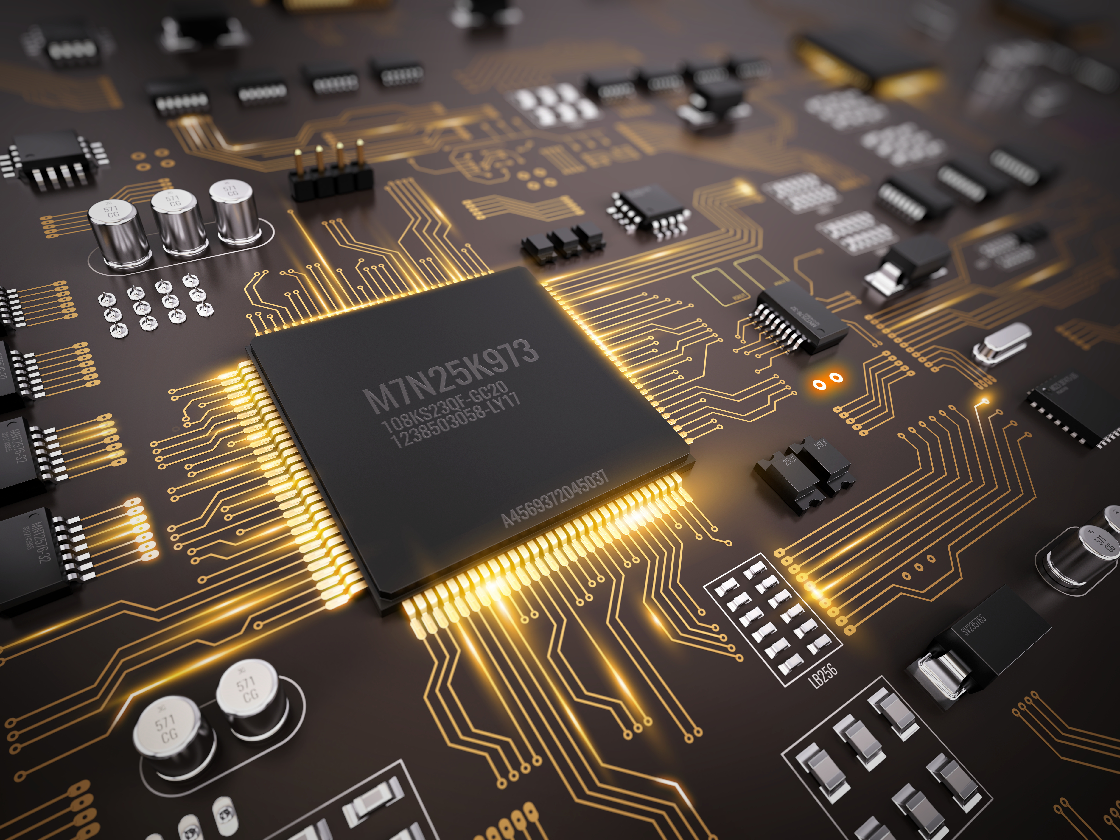
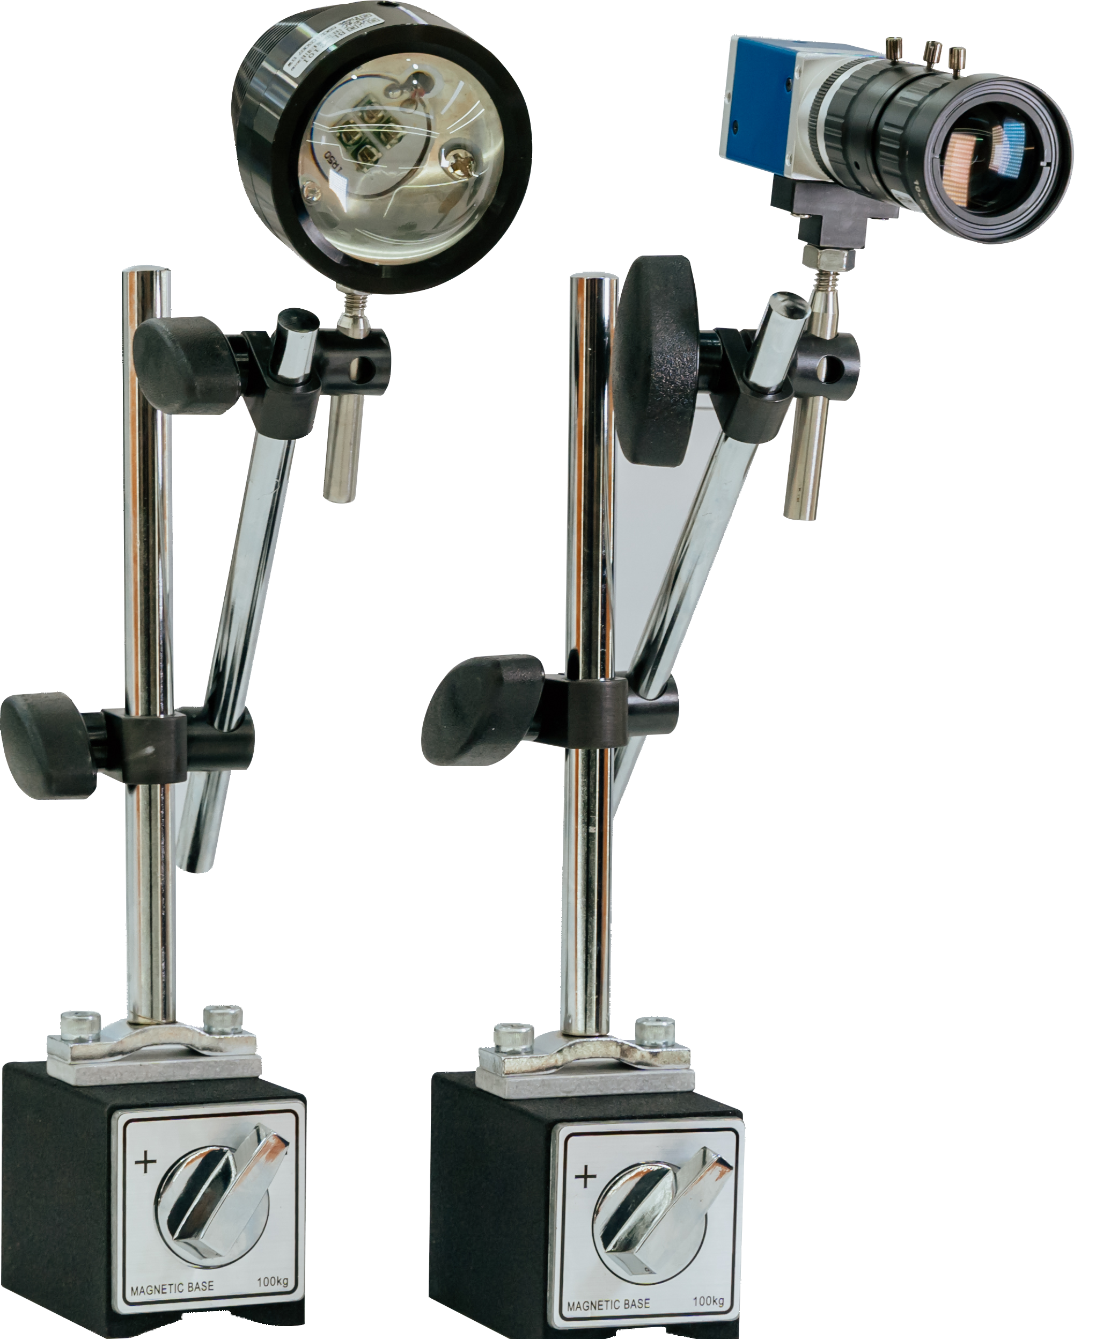
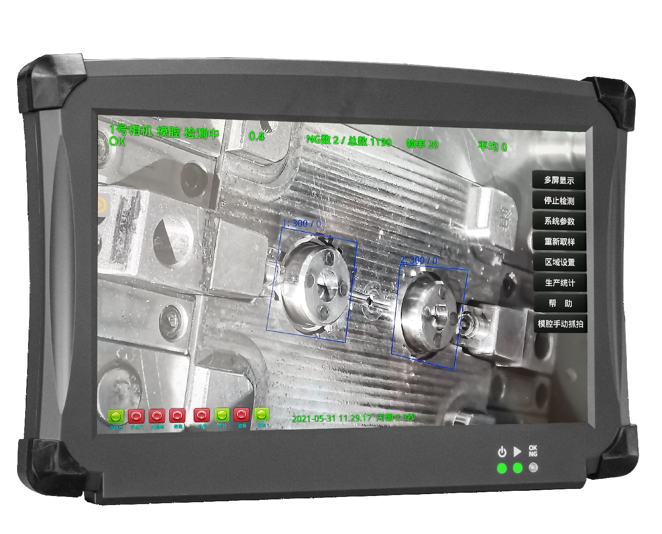
Product Introduction
Star products
Mold-Monitor
The mold-monitor, also known as the mold-protector or mold-electronic eye, utilizes machine vision for comparative and detection functions to perform real-time calculations on image data. It monitors equipment operation in real time, providing a non-contact solution to prevent molds from being crushed and ensuring no other damages occur inside the molds. It is characterized by its ease of learning and use, flexibility, and lack of industry or geographical limitations.
Check whether the product is short of materials or has insufficient injection.
Reduce unnecessary pin insertion times.
Check whether the molding is adhered to the fixed mold.
Detect mold temperature errors to prevent mold damage.
Check whether the placement of the insert is skewed, off center, or missing,
as well as whether it is deformed.
Check whether the top pin, slider, and neutron of the mold have been retracted into place before the mold is closed.
Check whether the molded product falls off normally before mold closure and whether the robotic arm returns to its original position.

Slide 4



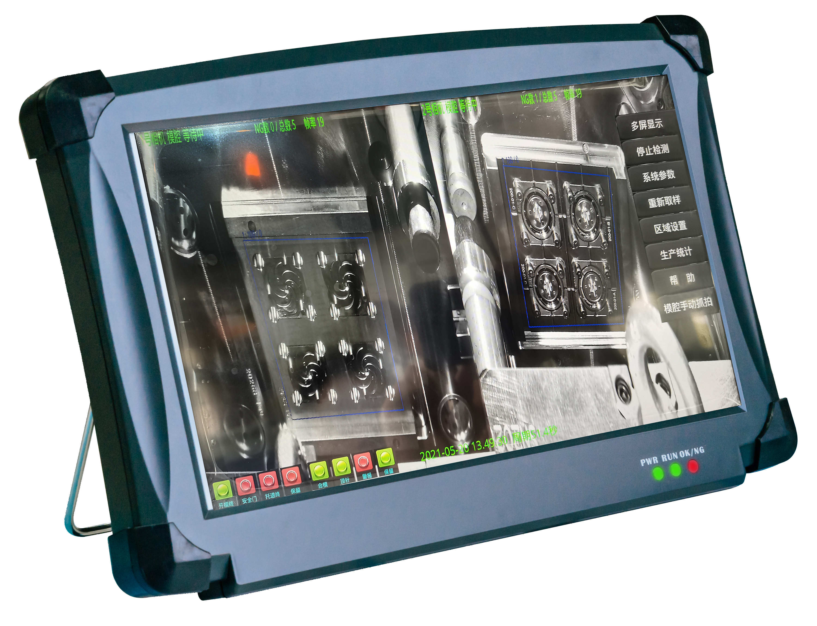
Core advantages
Core advantages
of mold-monitor
Widely applicable
Widely used in: medical/automotive/3C electronics/
home appliances/die-casting/stamping and other fields
Sales exceed 8000 units in 2024
BSYVisionLib Internationally leading algorithms+AI
Independently developed complete image algorithm -BSYVisionLib,
achieving internationally leading detection accuracy and significantly
improving production efficiency
High definition imaging efficient detection
Using CCD or global exposure CMOS cameras for high-definition imaging,
quickly and accurately capturing the inside of the moldProduction situation,
accurate recording of defect information, automatic correction of defect
information, can correct 10mm error.
One to many efficient linkage
One mold monitor corresponds to the in mold monitoring system of multiple injection molding machines, greatly saving procurement costs.
Mold Monitor IoT Management System
It can integrate the status parameters of all mold monitors and real-time
images of each camera, and transmit them to the central server for remote
viewing and management.
Thermal imaging temperature monitoring alarm function
By using an online thermal imaging camera and the thermal imaging module in the software,
the mold temperature during the injection molding production process can be monitored,
and any abnormal temperature will immediately trigger an alarm

Slide 5
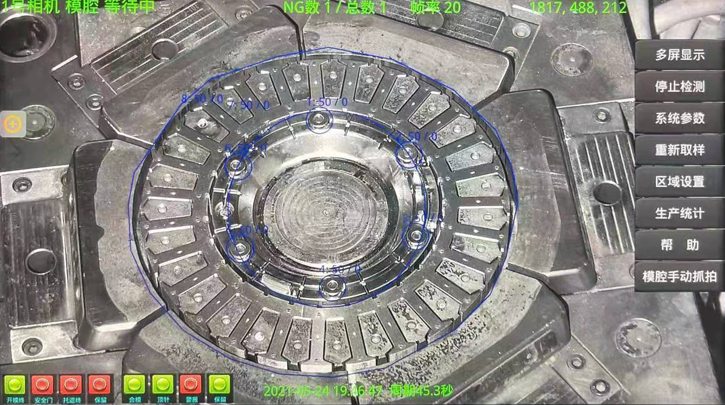
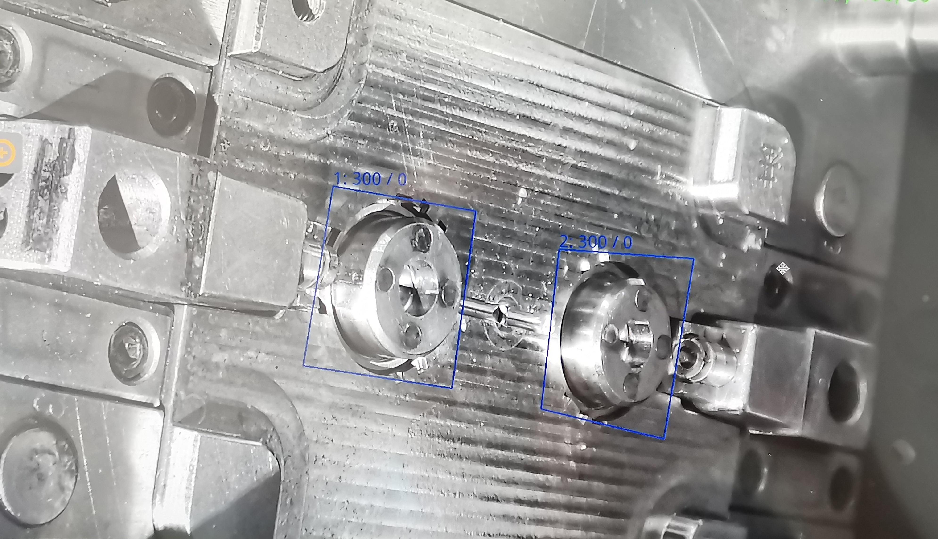
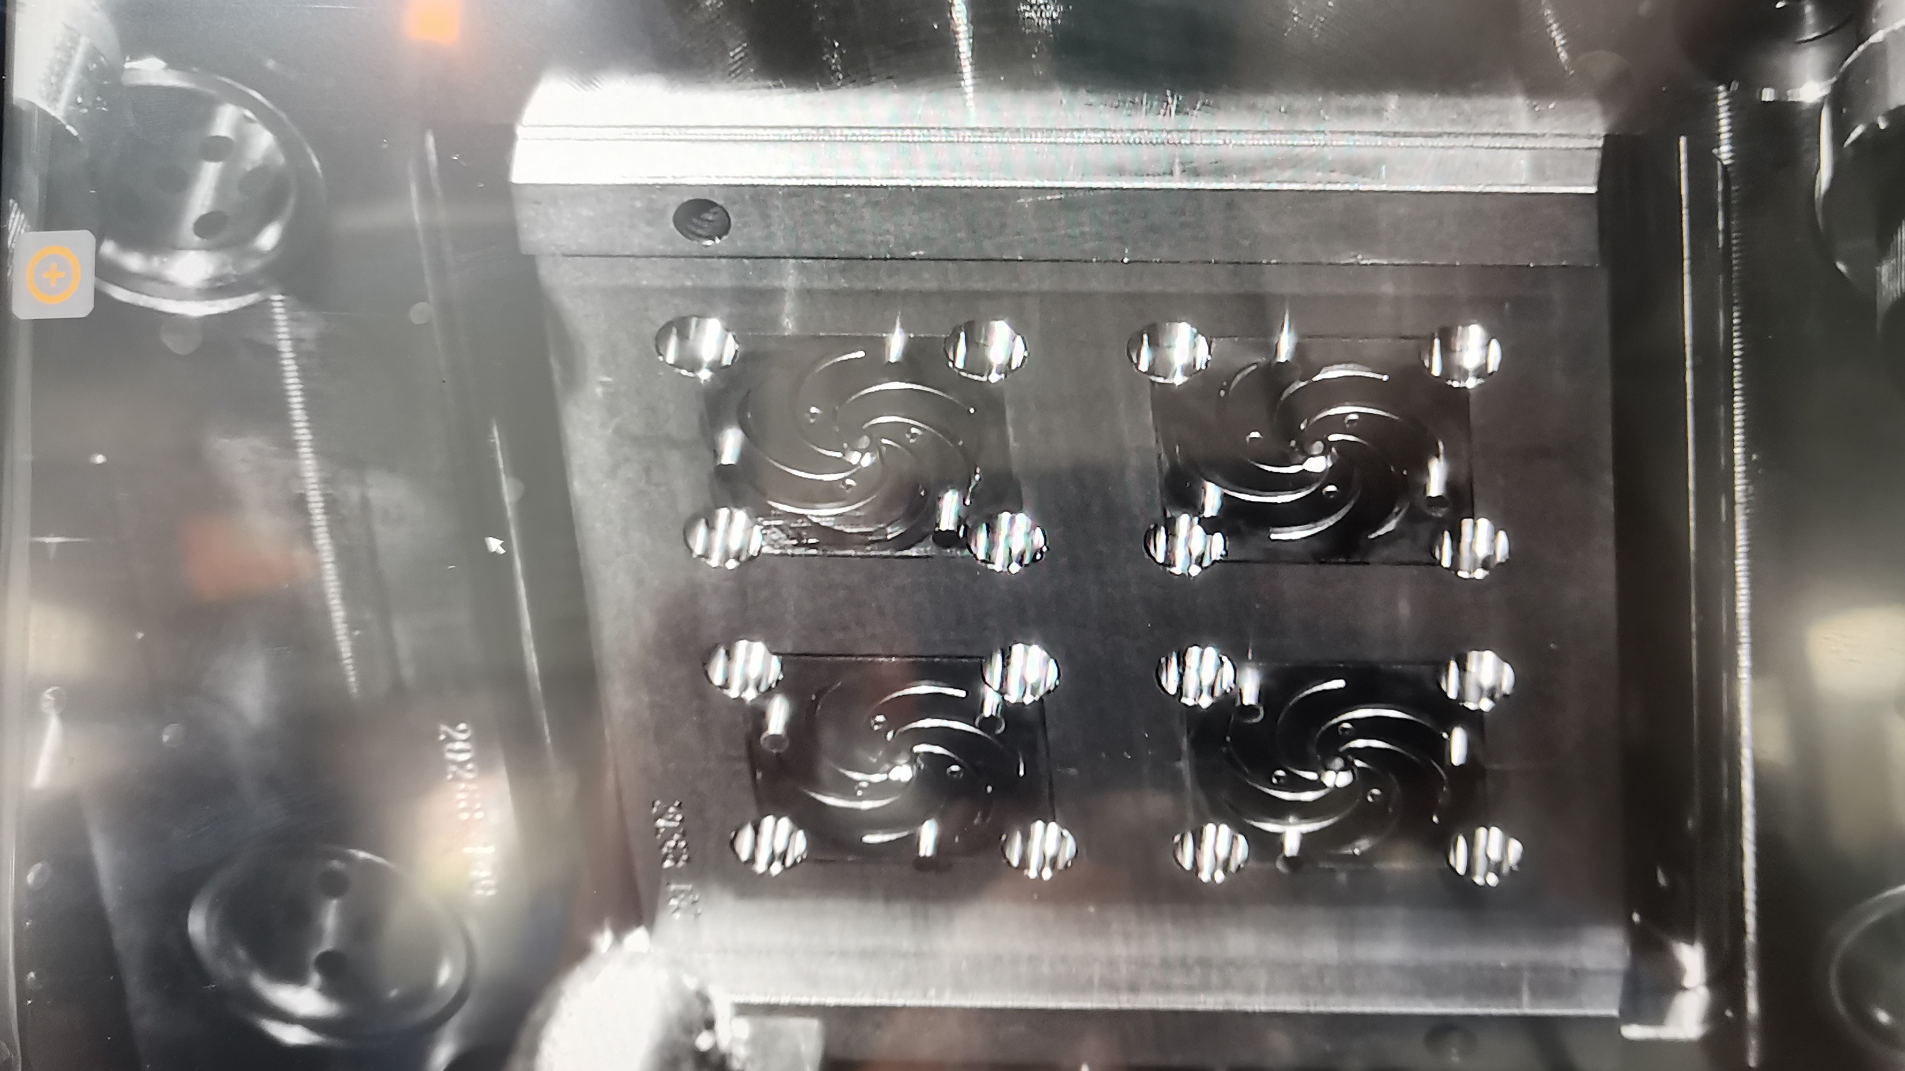
Configuration parameter
Mold-monitor configuration and parameters
▽ Mold monitor detection screen
Name of configuration | Configuration parameters
screen size | 13.3 Inches
CPU model | J6412
CPU main frequency | 2.6GHz
MB RAM | 8GB
RAM | M.2-2280 256GB
Operating system | Linux
Graphics card | IntelUHD Graphics for 10th Gen IntelProcessors
rated voltage | DC 12V-35V(wide voltage)
Whole machine weight | 1.6kg
Camera | 6 million pixels (Ethernet camera)
Lens | 6 million pixels (customized)
Screen resolution | 1920*1080
Frame rate | 20

Slide 6
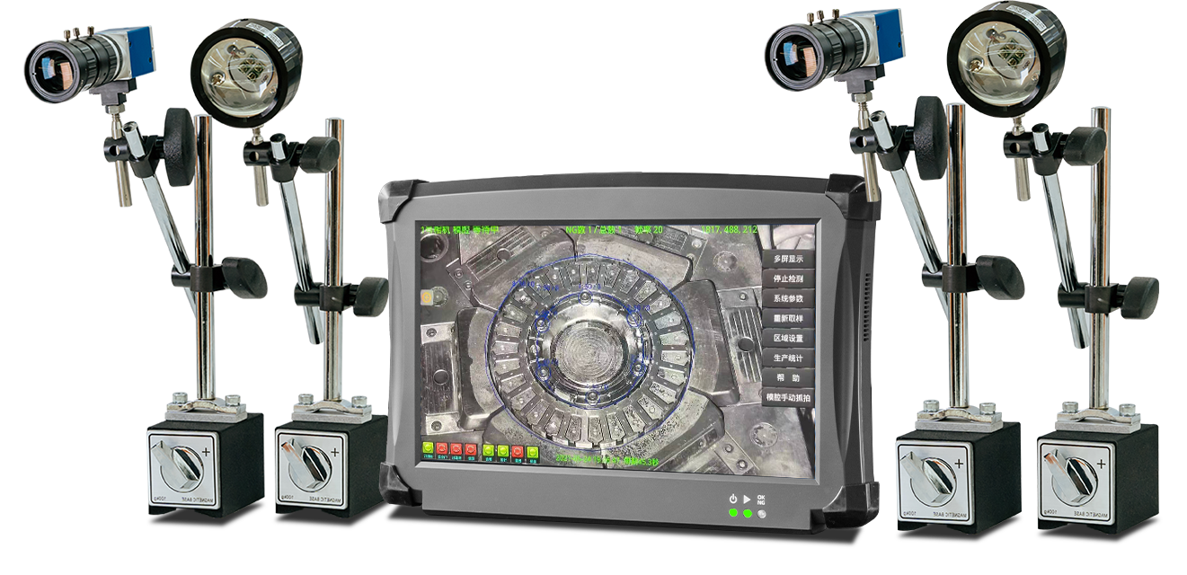
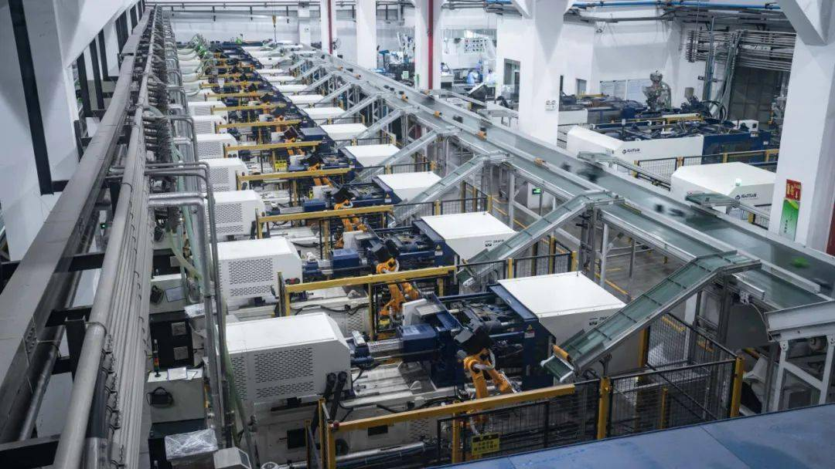
Big Data Management System
Nowadays, the global industry is constantly advancing towards the era of 4.0 intelligence. Traditional injection molding/stamping workshops are also facing pressing problems during in mold production. However, due to insufficient layout in the early stage of the workshop or hardware equipment update costs, even if commonly used mold monitors are installed on the market and initial in mold monitoring visualization is achieved, they cannot truly transform into intelligence.
In response to this pain point, our company has upgraded and transformed our third-generation mold monitor, adding network modules and developing a big data management system, enabling users to achieve a truly intelligent transformation in injection molding/stamping production. In response to the new workshop, the equipment can be directly adapted to provide big data collection and management for the workshop.
One person is responsible for one terminal
When the mold is abnormal, it can only be operated on-site
The cost of upgrading equipment to intelligence is high
Difficult to establish MES
Transforming
towards intellig ence
Monitor multiple terminals simultaneously
Integrate a production detail diagram
Test report
Remote parameter setting
Expansion window without network port
No data report statistics
Detecting video/NG video backtracking
Generate a report of detected NG data
NG records for statistical analysis
Traceability of operation records for a single terminal
System software update log
Comparison of data from all terminals
Create Manufacturing Execution System
The cost of modifying the terminal to achieve remote visualization is very high
.........

Slide 7

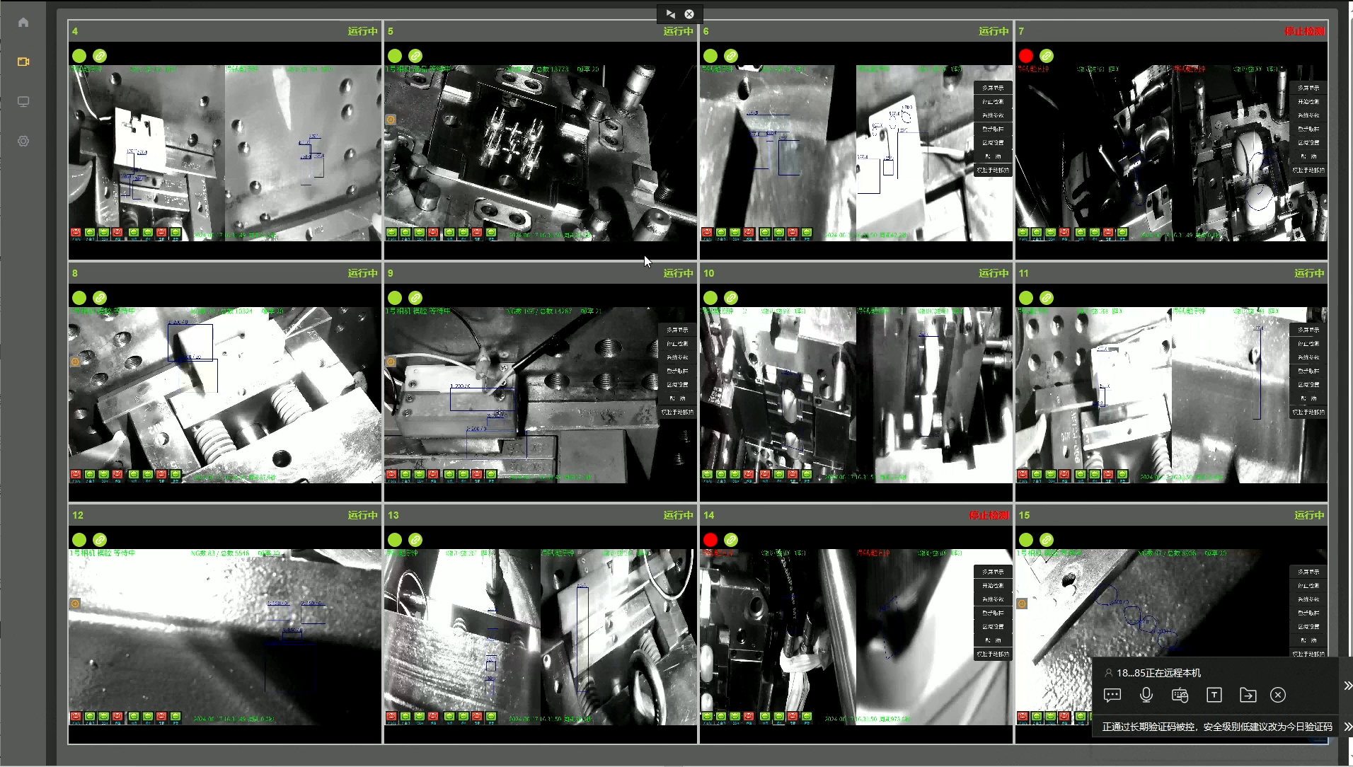



Big Data Management System
Remote visualization of molds on user terminals and real-time monitoring of integrated interfaces
upgrade
User's terminal device×N ▷ Monitoring/operation workstation×N
User's terminal device×N ▷ Monitoring/operation workstation××1
Intuitive display of live
in mold conditions
Significant reduction
in labor costs

Slide 8
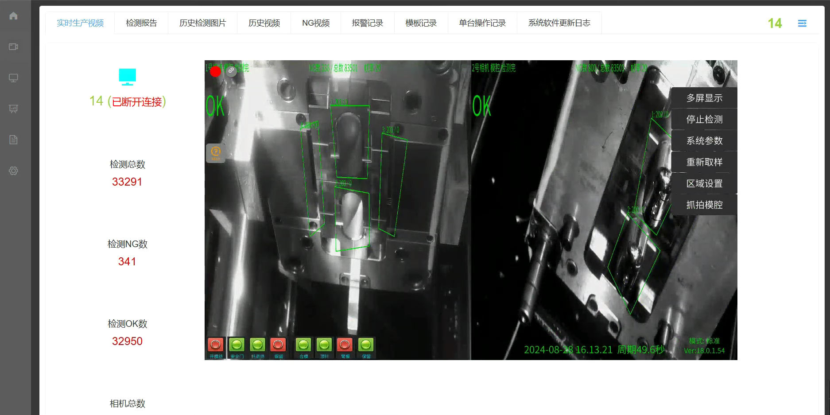

Big Data Management System
Real time product production video
Remote and up close viewing
of mold travel
Remote operation of mold monitoring parameter settings
Adjustable detection sensitivity, alarm area, and detection box adjustment
Occasionally there is a false alarm, but the cause can be immediately investigated with human eyes to restore the operation of the production line

Slide 9
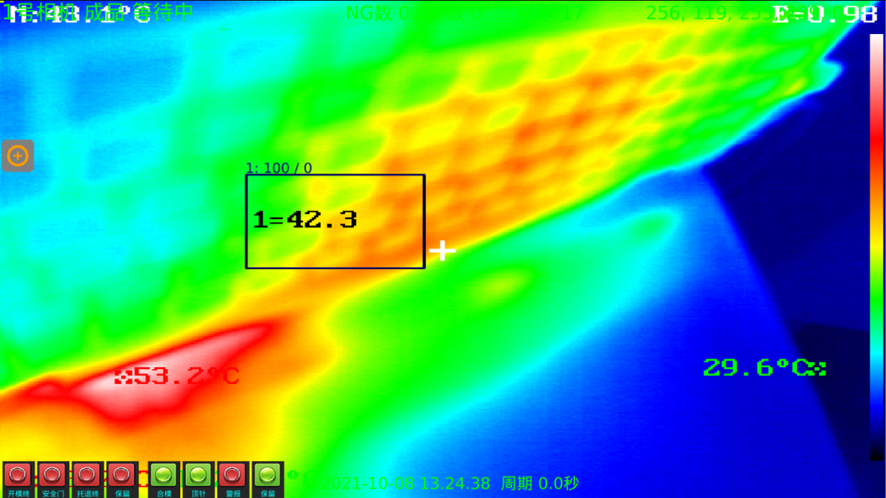
Thermal imaging mold monitor
Add thermal imaging temperature detection
Model | MP-T900 Online temperature measurement thermal imager camera
Sensor type | Vanadium oxide uncooled detector
Resolution | 384x288
Frame rate | 50 Hz: 50 fps
The closest focal length of a thermal imaging lens | 6.8mm
Max Aperture Value | F1.0
The closest distance for thermal imaging imaging | 0.6m
The farthest distance for temperature measurement（0.1x0.1m） | 6m
Viewing angle | 56°x41.7°
Palette | 15 types including White Heat, Black Heat, Fusion 1, Rainbow, Fusion 2, Iron Red 1, Iron Red 2, Dark Brown, Color 1, Color 2, Ice Fire, Rain, Red Heat, Green Heat, Deep Blue, etc
Temperature measurement accuracy | ± 2 ℃ or ± 2 ℃ of the reading
Measuring range | -20 °C~150 °C or 0 °C~550 °C
Intelligent information overlay | 10 point temperature measurement, 10 box temperature measurement, 1 line temperature measurement
Maximum number of preview paths | 20
Video compression standard | H.265/H.264/MJPEG
Network interface | 1 RJ45 interface 10 M/100 M/1000 M adaptive Ethernet port
Shell material | Aluminum magnesium alloy
supply voltage | DC 10~30V
In some injection molding and stamping industries, some products have precise requirements for mold temperature. Once there is a certain temperature error, it is easy to cause abnormalities in the product. However, the cost of retrofitting the equipment with contact type temperature monitoring remains high.
Our self-developed thermal imaging mold monitor MP-T900 is equipped with non-contact thermal imaging recognition, customizable temperature measurement area and alarm range, and compatible with traditional visual inspection systems, making it a perfect solution.

Slide 10
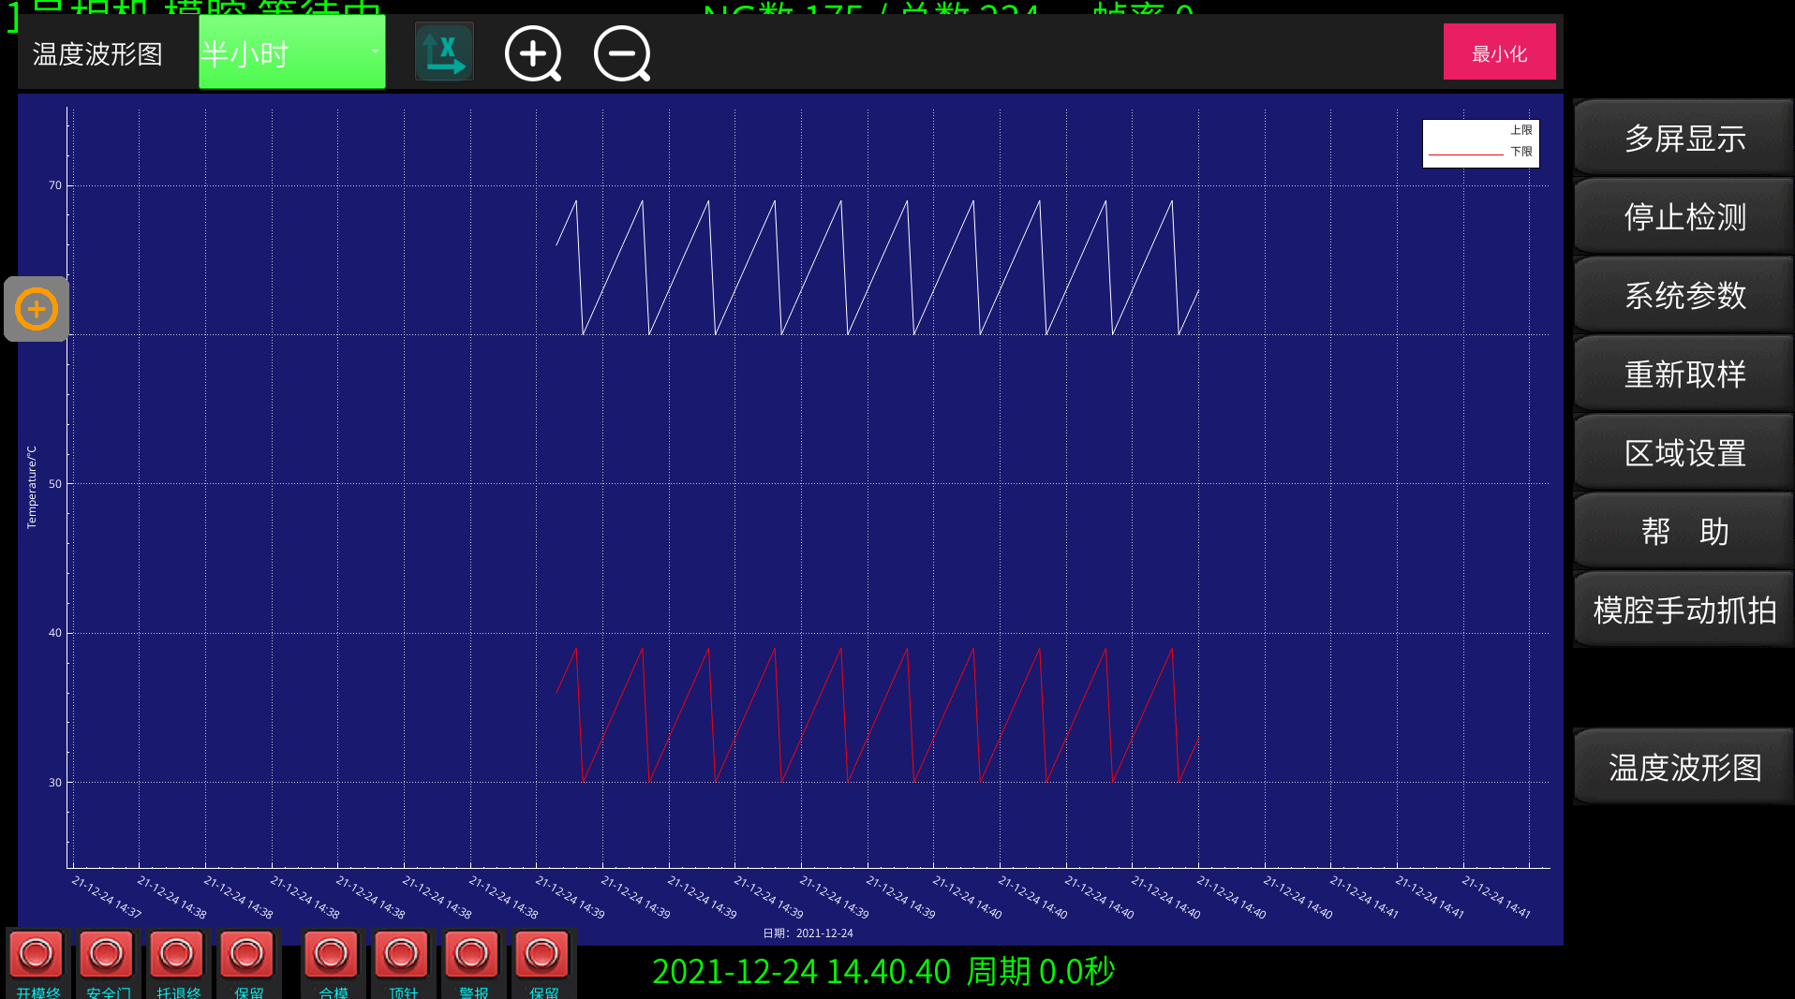






Thermal imaging mold monitor
Function Explanation
Thermal sensitivity≤55mk
thermal response
time＜15ms
Non contact temperature measurement
Customizable temperature measurement area
4 temperature measurement modes (low temperature, medium temperature, high temperature, custom)
Automatically record every temperature measurement data
Measured data
Automatically generate waveform diagrams
Customizable time period view relevant waveform diagrams
Low temperature alarm and high temperature alarm can be set

Slide 11
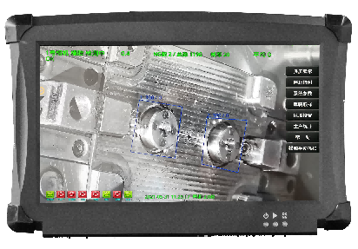







Other functions
Other functional features
Automatically generate detection areas and parameters - improve debugging accuracy, reduce user operation steps, and shorten debugging time;
Foolish one click operation, beginner operation guide - the system comes with a one click tutorial that automatically sets up relevant programs. Technicians only need to follow the set steps step by step, without the need for human training, to learn how to operate the basic functions of the Boshiyuan monitor;
Automatic correction of displacement deviation during mold opening stroke - a self-developed dynamic mold drift correction algorithm that has been verified to correct a 10mm error, with this function being most evident in older hydraulic presses;
Automatic light compensation and correction - For reflective and dark areas, our independently developed light compensation algorithm can automatically identify relevant areas, correct them, and achieve overall brightness balance. This function is particularly effective for metal embedding;
The latest model matching algorithm based on contour can effectively solve the problem of misalignment of embedded parts and steel plates, as well as misjudgment caused by color difference;
The latest developed mold monitor corresponds to the in mold monitoring system of multiple injection molding machines, which can be applied in a relatively simple application environment to detect whether products have fallen off the mold normally, greatly saving customers' procurement costs;
Optional function: Monitor abnormal alarm can send SMS to the designated technician's mobile phone to ensure efficient and real-time processing of abnormal alarms;

Slide 12
Thanks for watching
VISION
INSPECTION

