Slide 1

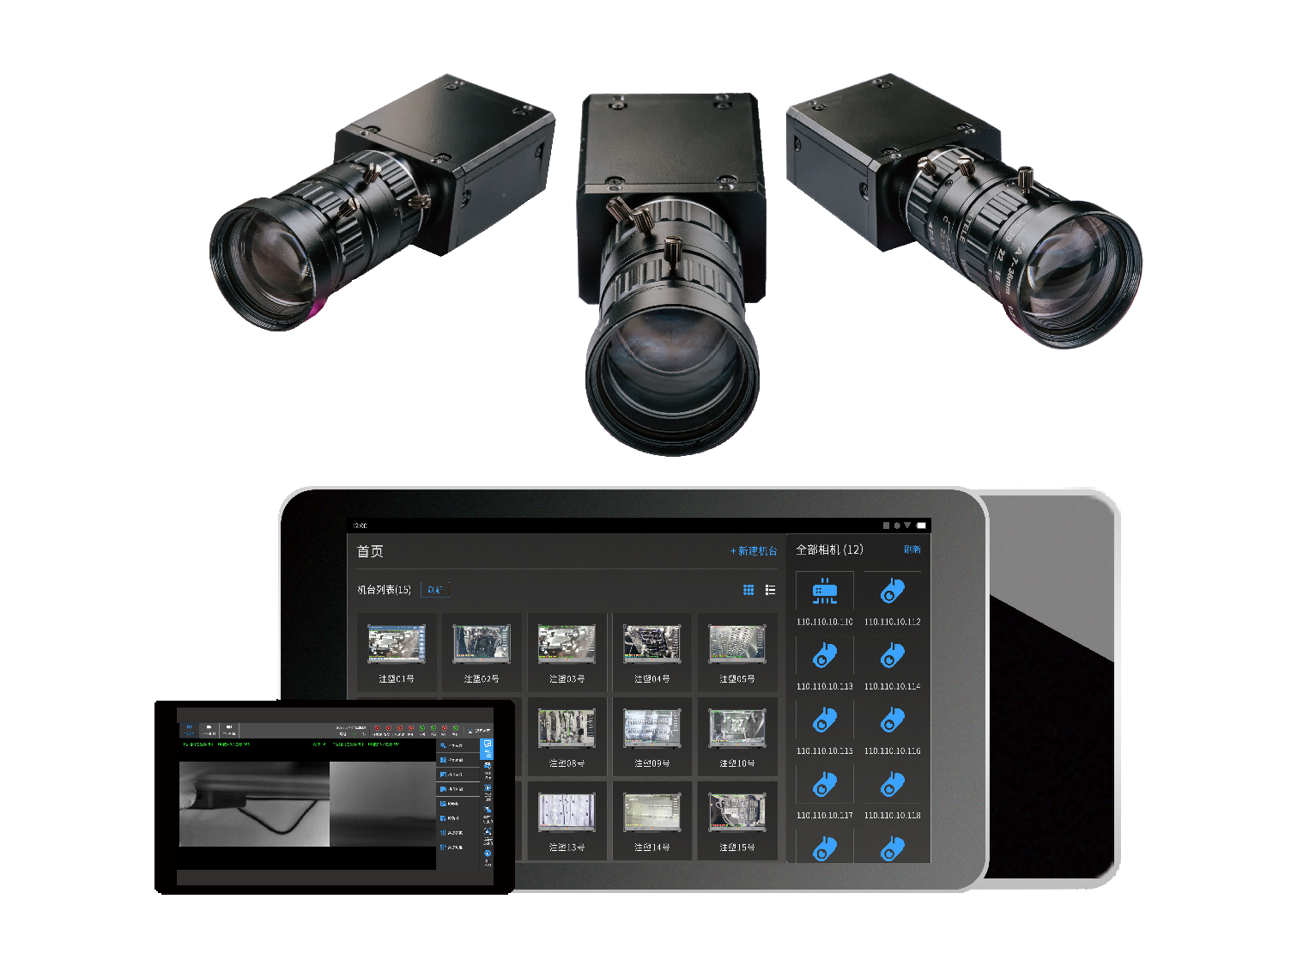
Intelligent Mold Monitor
Terminator of Traditional Mold Monitor | Fourth Generation Intelligent Mold Monitor
XIAMEN BOSHIYUAN MACHINE VISION TECHNOLOGY CO,LTD

Slide 2
Application Scenario
Product Upgrading
Application Area
Configuration

Slide 3
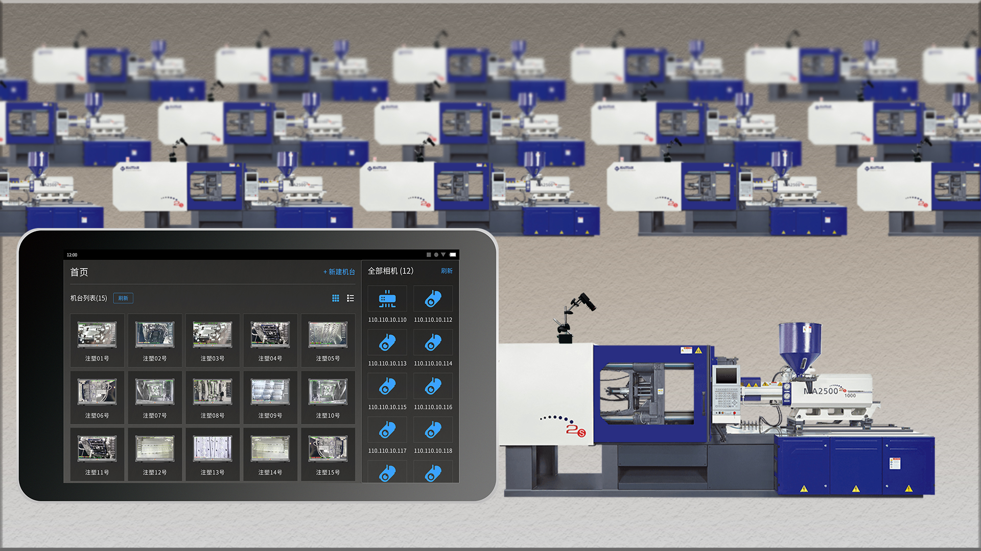
1.Application Scenario

Slide 4
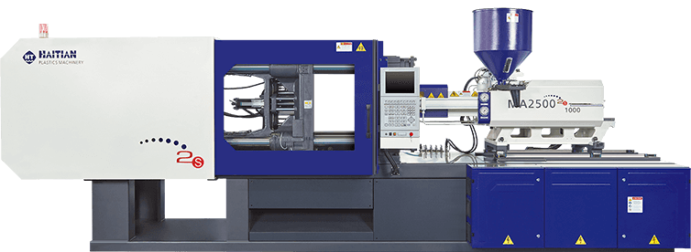
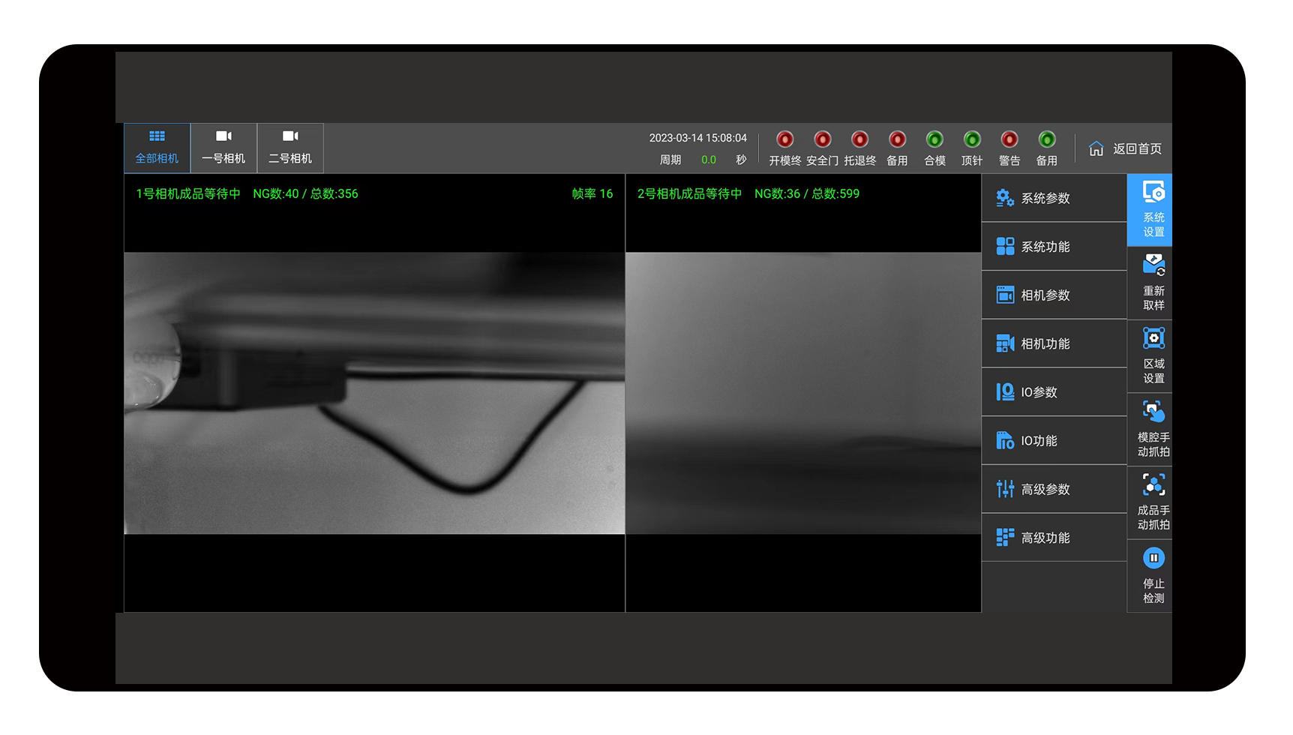
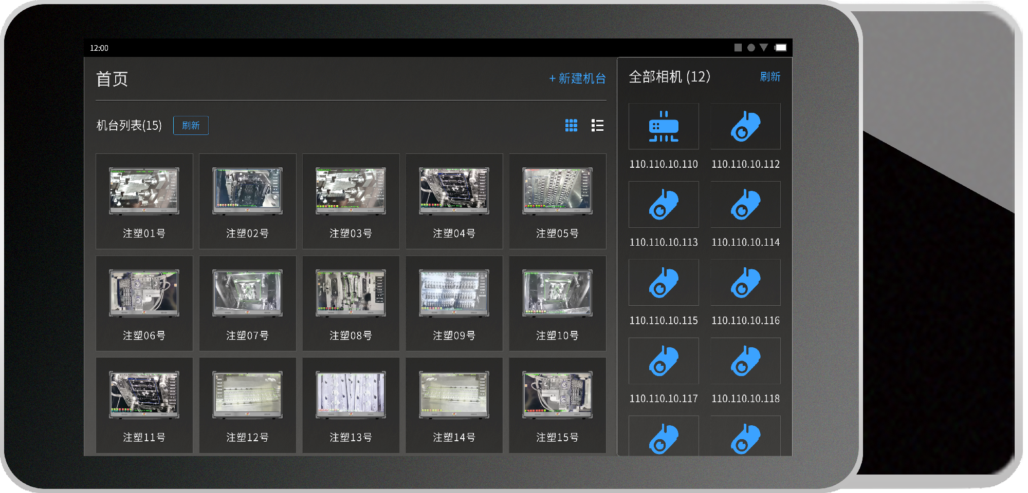
2. Product Upgrade - Hardware Costs
 | Third generation mold monitor | Fourth generation intelligent mold monitor
Hardware cost | One injection molding machine is matched with a set of screen host. Purchase multiple units, with a hardware cost of 1 * N | No host or screen design, procurement cost is 80% of the old model Dozens of terminal devices share a mobile terminal (shell optional tablet/phone) for display and control
终端*∞

Slide 5

2. Product Upgrade - Labor Costs
 | Third generation mold monitor | Fourth generation intelligent mold monitor
Labor costs | Mold monitoring and control require dedicated personnel to be on duty, and each person can supervise ≤ 5 devices | Real time upload of monitoring data, one person can monitor N detection stations, greatly reducing labor costs
Operation station * N

Slide 6

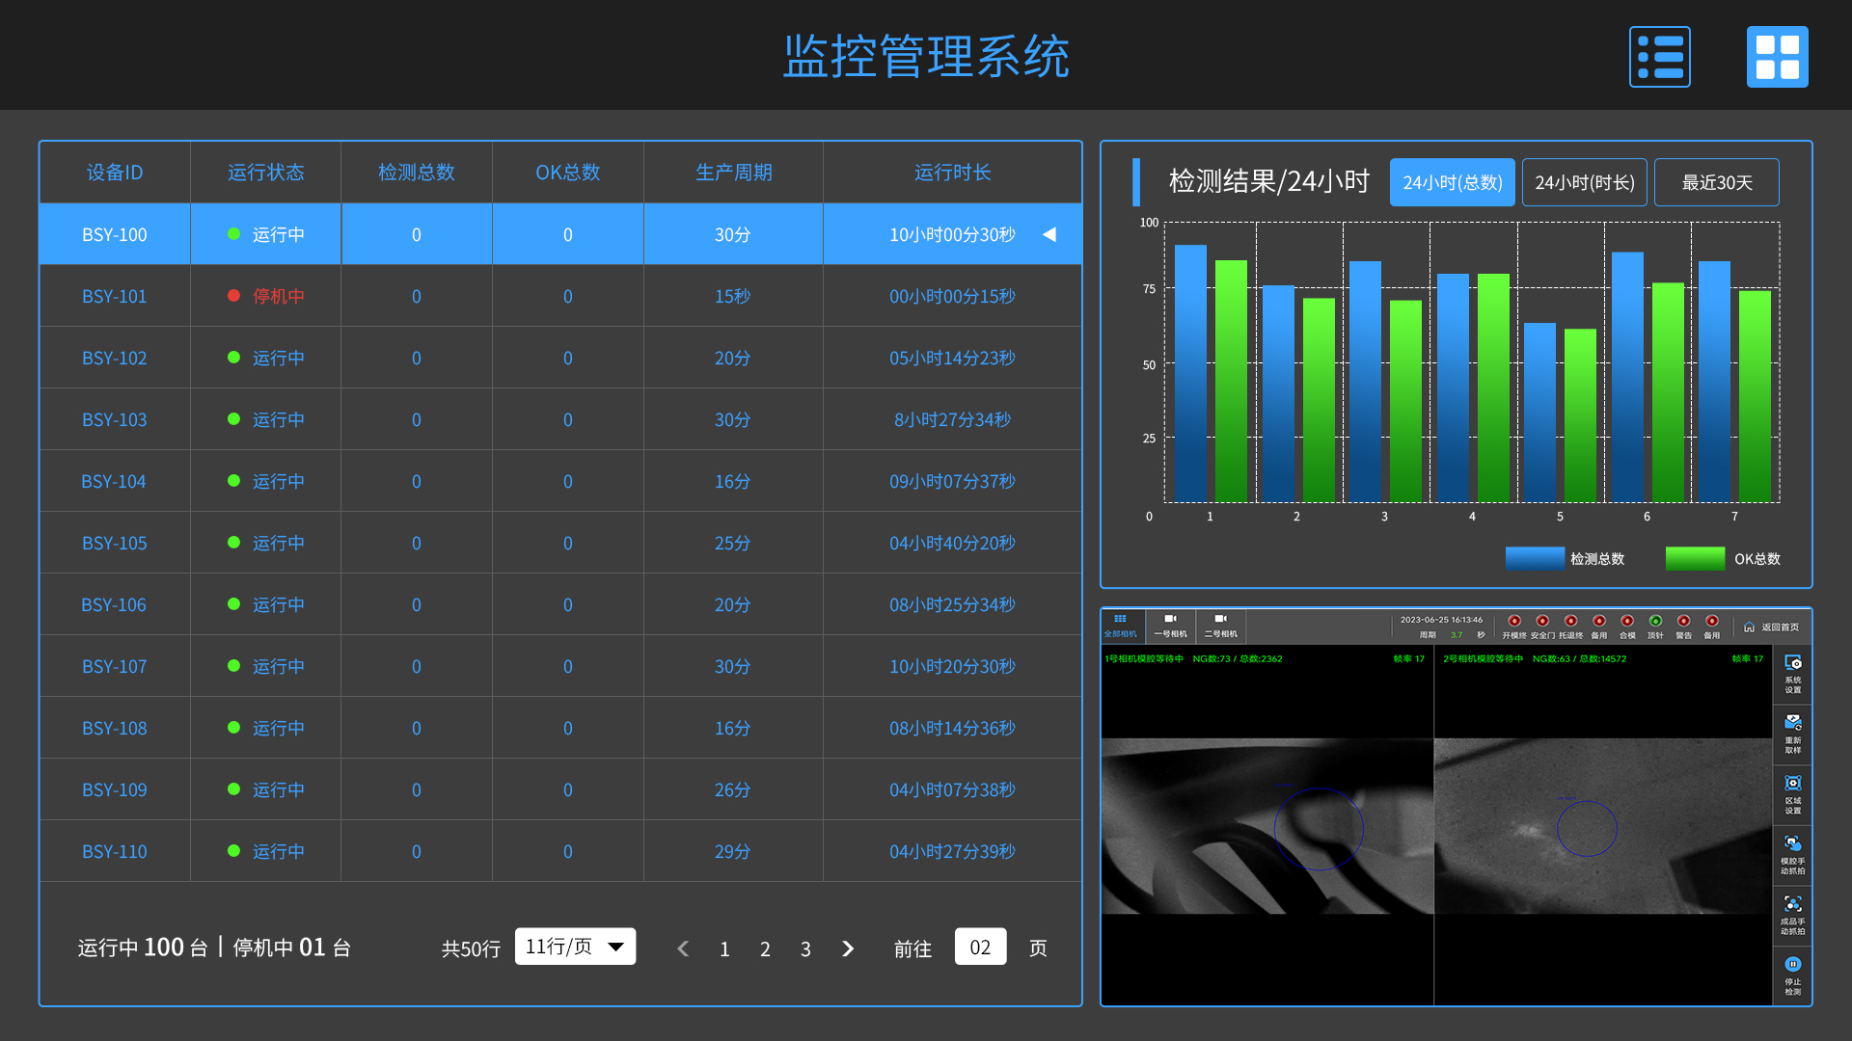




2. Product Upgrade - Establish MES System
Establish MES system | Third generation mold monitor | Fourth generation intelligent mold monitor
 | Unable to create and connect to the Mesh system | Based on wired network layout, terminal connectivity within the workshop can collect real-time monitoring data of injection molding machines through the fourth generation mold monitor. Real time production data and historical statistical data can be projected to the workshop data dashboard and the company management office, achieving the establishment of a production workshop MES system and upgrading the intelligent workshop.
Wired layout
Corporate network
Wireless transmission
User terminal
Workshop data dashboard
Management Office
Matching quantity switch
......
Operation workstation tablet wireless monitoring
Workshop router

Slide 7

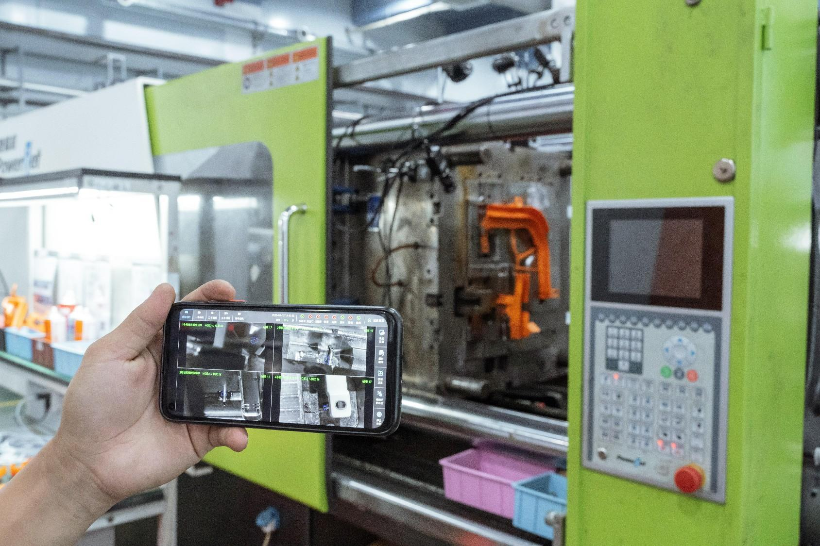
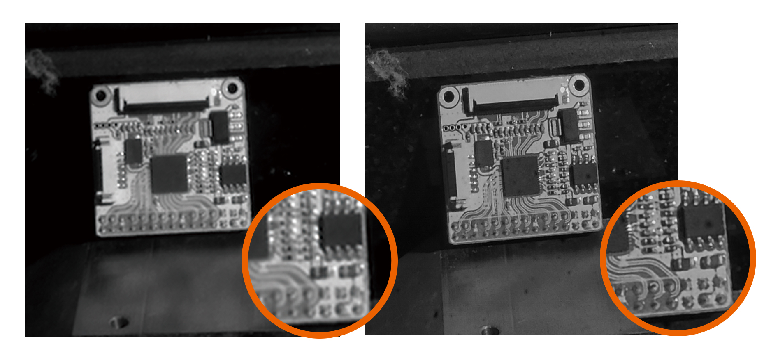
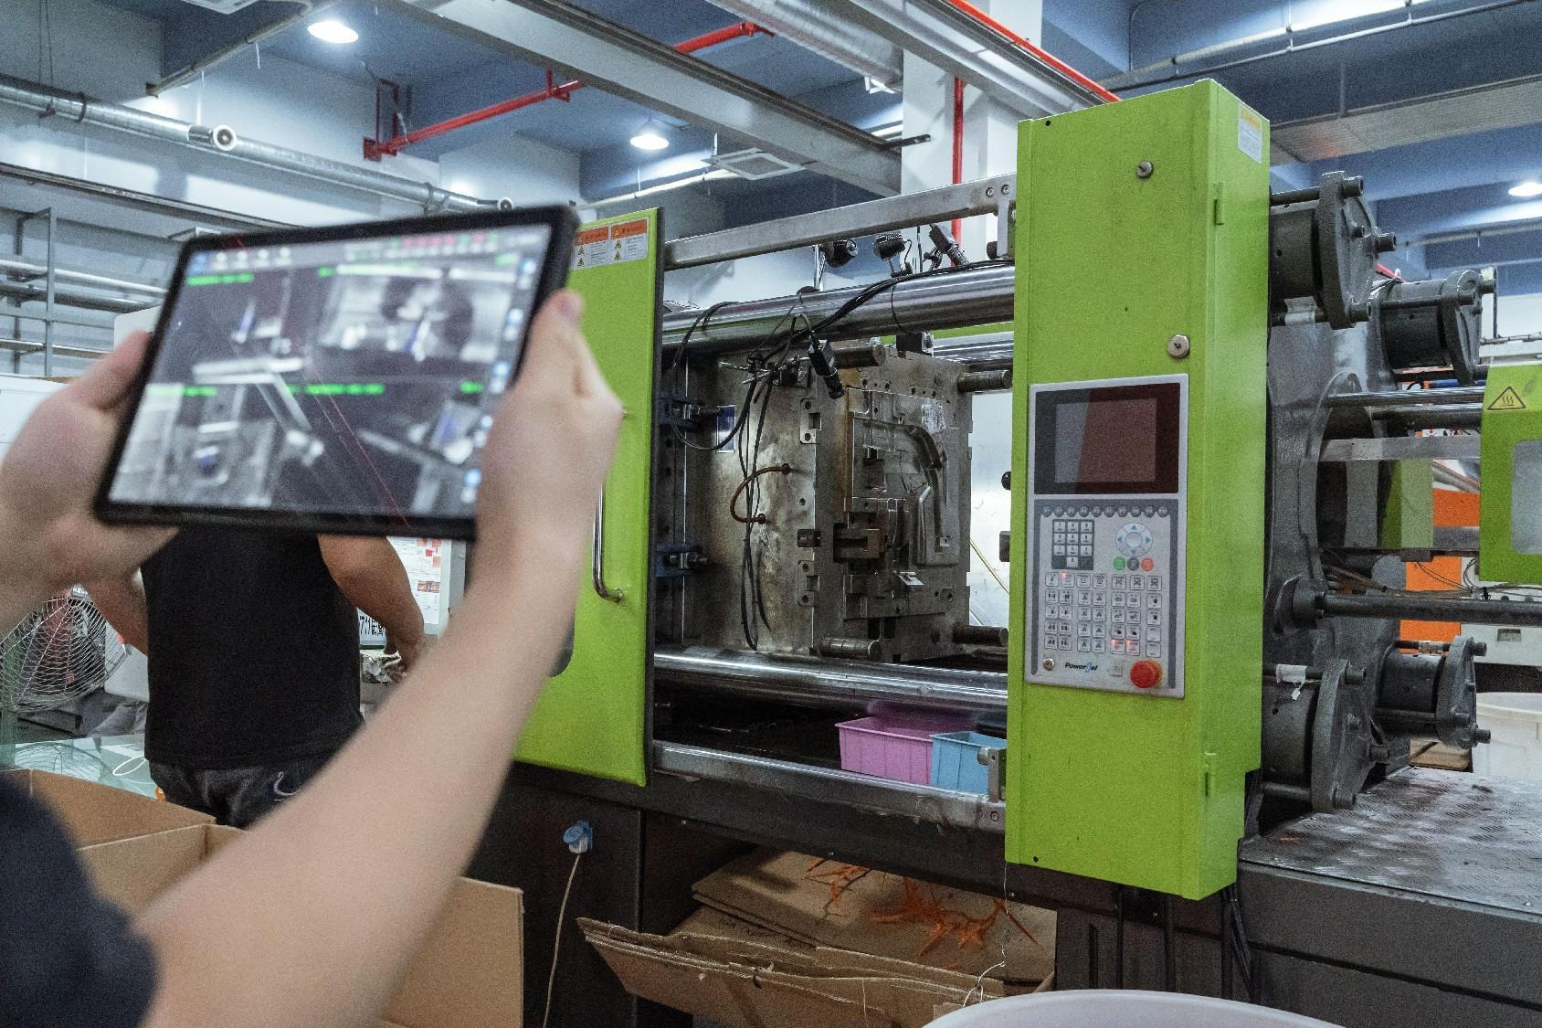
2. Product Upgrade - Production Efficiency
 | Third generation mold monitor | Fourth generation intelligent mold monitor
Debugging and upgrading methods | Program issues and system upgrades require engineers to handle them on-site, with latency | Can connect to the internet for online backend debugging and online upgrade
Imaging effect | Traditional industrial cameras have poor imaging clarity in specific low light environments, making it easier to misjudge alarms | Adopting self-developed cameras, further improving imaging resolution and effectively reducing misjudgment rates
Convenience of operation | The operating terminal needs to be wired and fixed next to the mold. In case of mold abnormalities, the staff should monitor and handle them at the terminal | The operating end is a wireless tablet/phone, and wireless mold monitoring and terminal operation can be carried out through the mobile app within the local area network

Slide 8
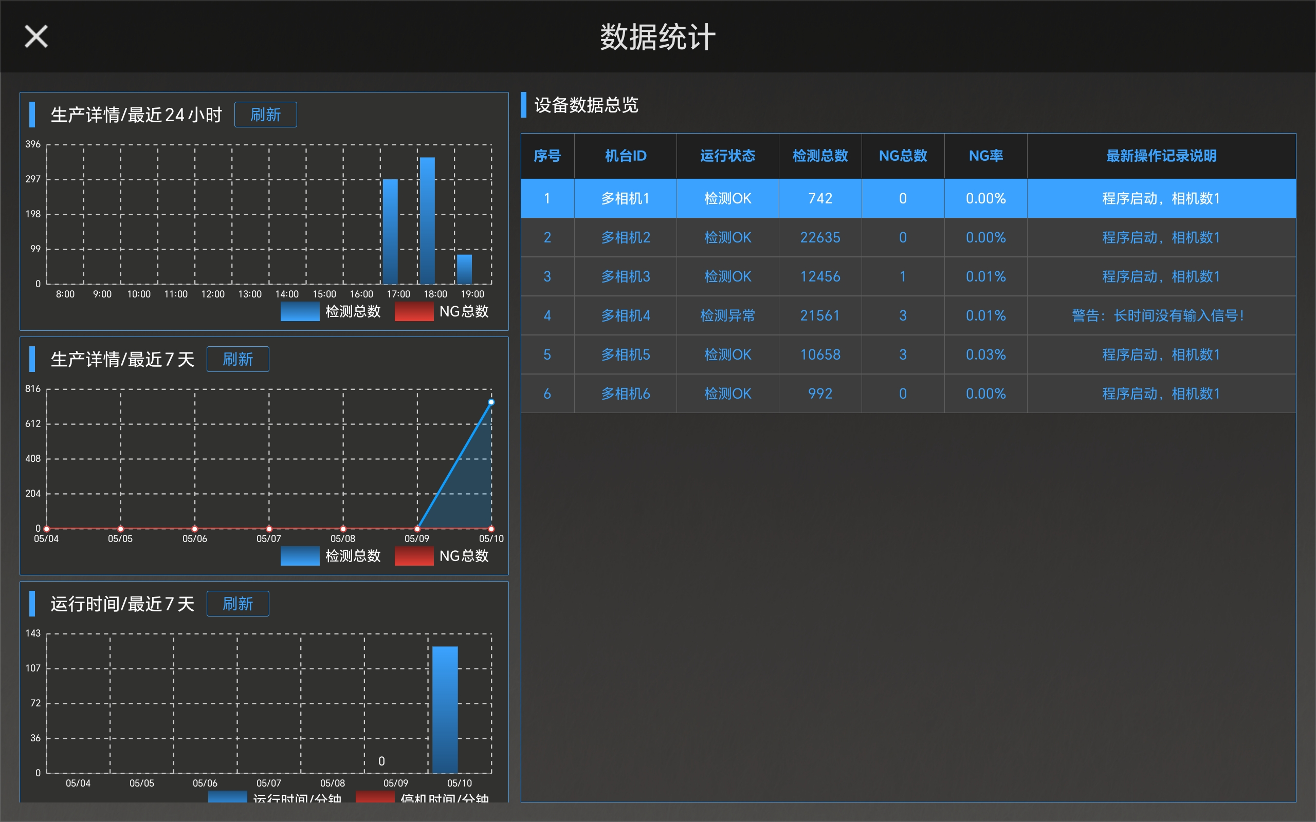
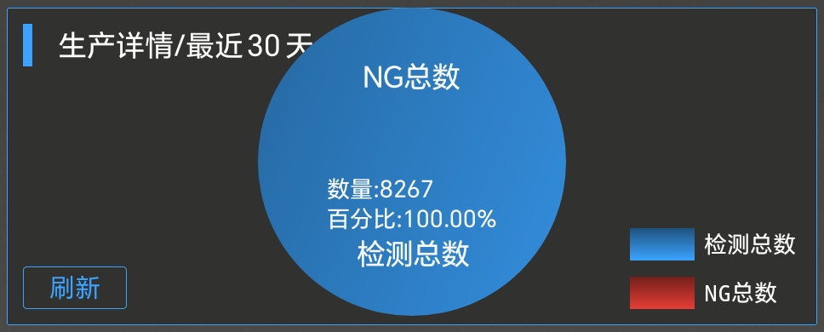
2. Product Upgrade - Data Management
 | Third generation mold monitor | Fourth generation intelligent mold monitor
Data managemen | No detailed data statistics function | Real time upload of data, visualization and visualization of data, creating a more intuitive new way of digital collaborative management

Slide 9
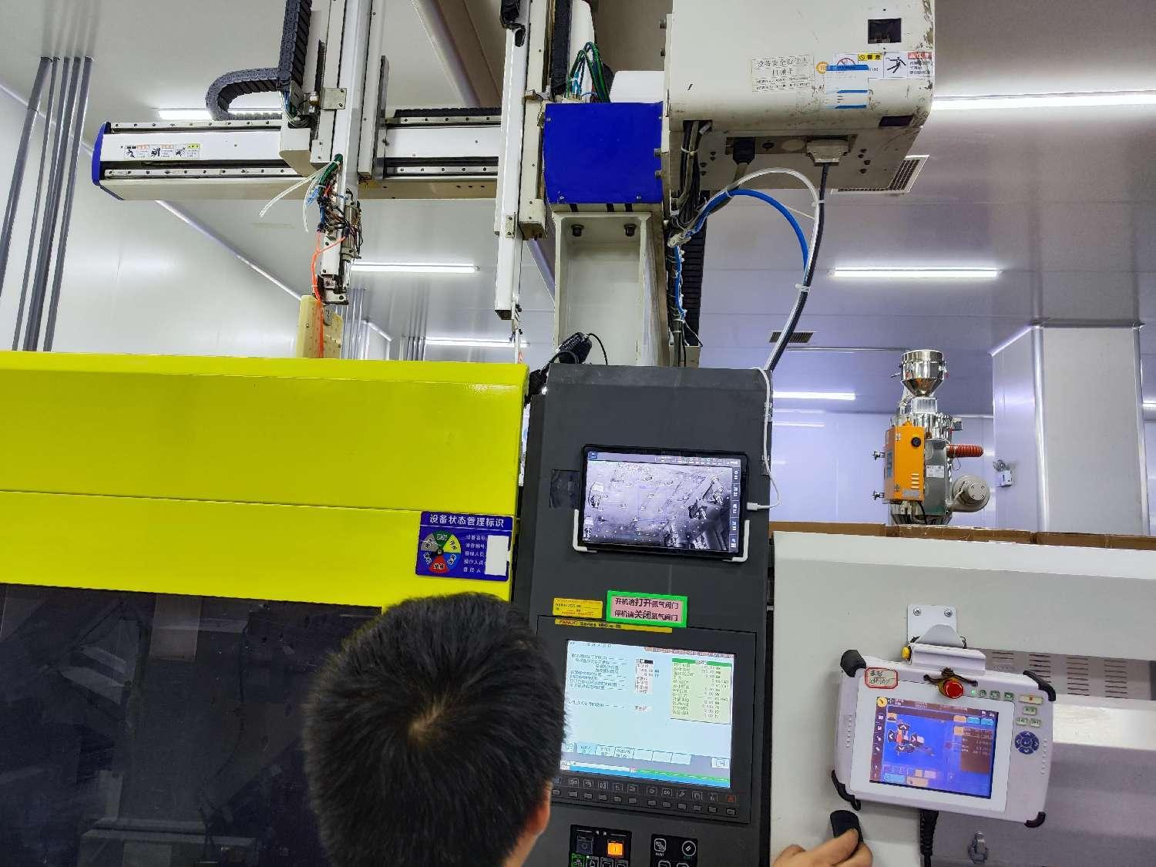
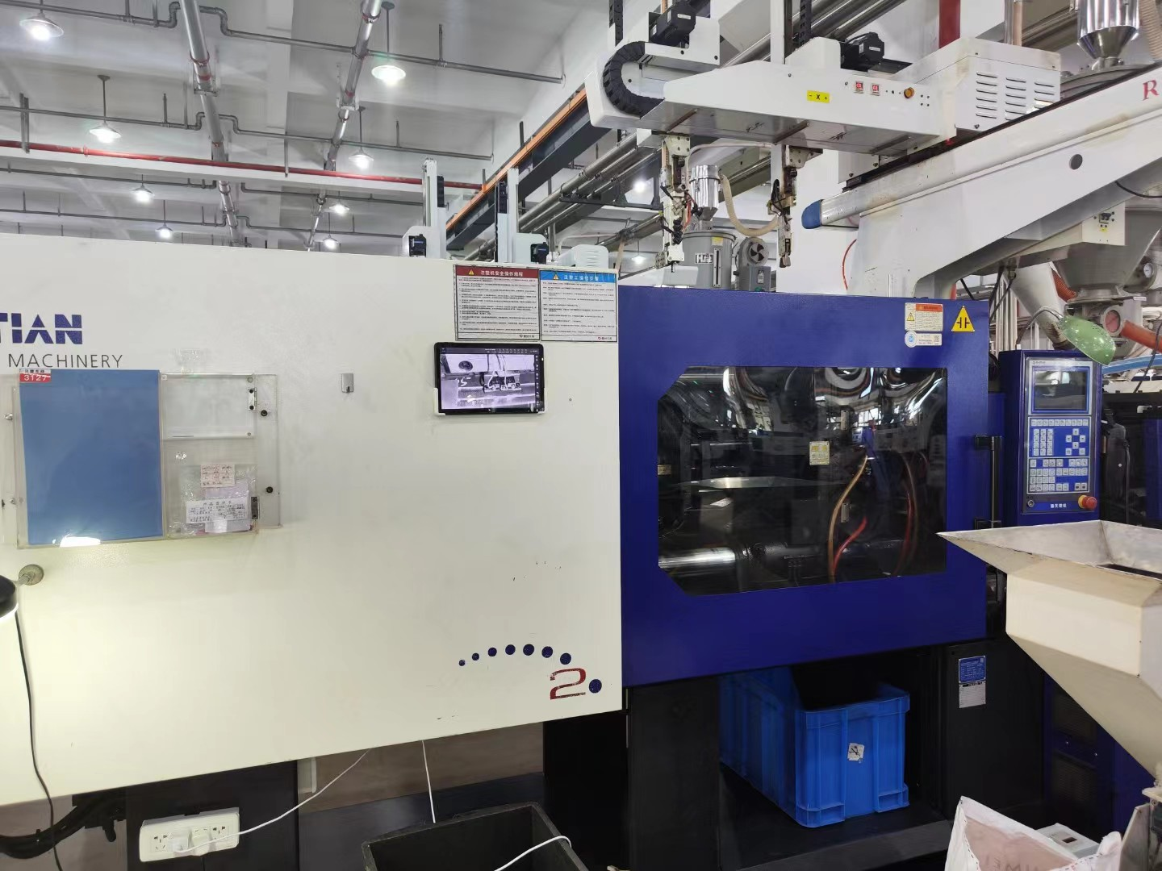
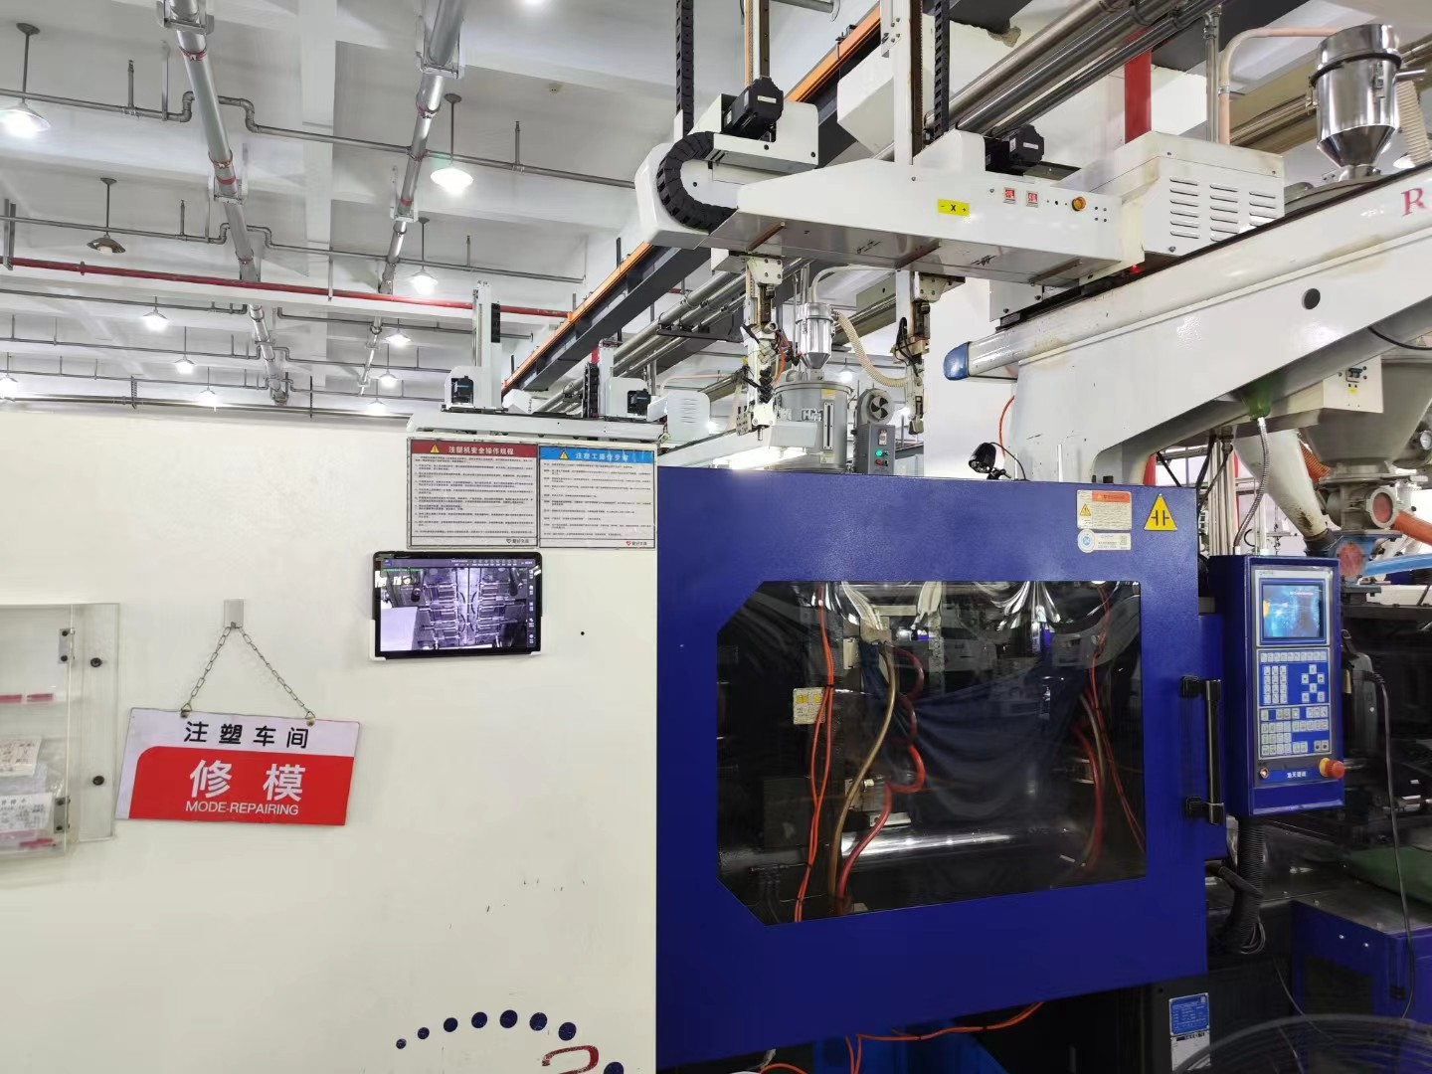
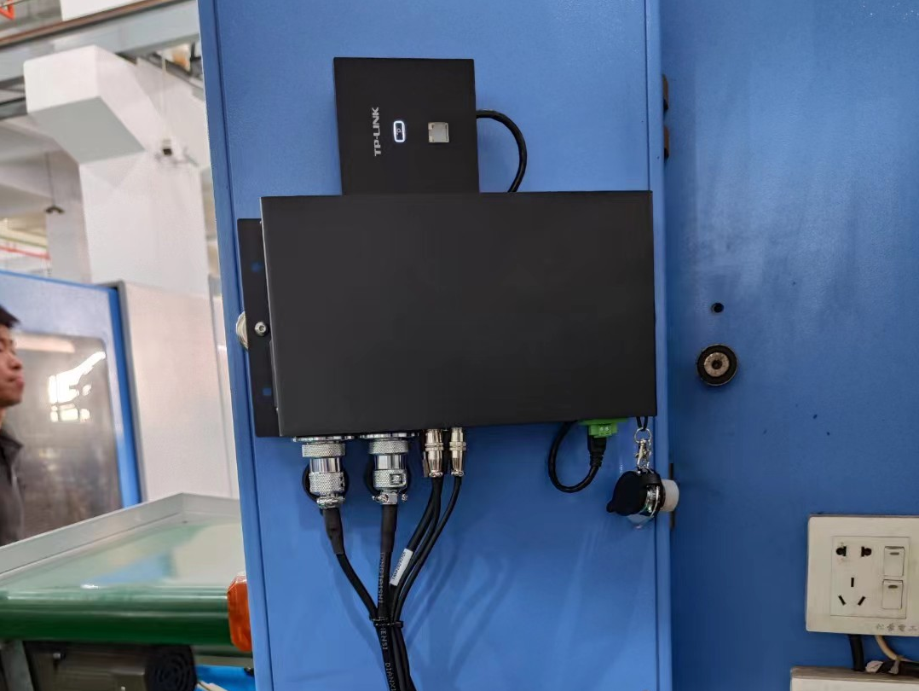
3. Application field
Technology
Injection molding process
Stamping
Die casting process
Industry
Auto Parts
3C Electronics
Home appliance accessories
Medical Instrument
Data collection
Production
yield rate
Single machine production efficiency
Multi machine monitoring
Annual sales volume 3000+
Data upload
Industry 4.0

Slide 10
4. Equipment configuration
The configuration will be updated irregularly, and shall be subject to the technical agreement or quotation.
Hardware parameters of the fourth generation mold monitor
CPU | Arm chip
Resolution | 1920*1080
Frame rate | 30FPS frame rate
Shot | Wide angle to mid focus (12-36mm) lens
Sensor | Stacked CMOS sensor
Fourth generation mold protection configuration list | Brand | Specifications | Unit
Ipad | Lenovo/Honor (optional) | 10.1 inches | Tower
AP panel/router | TP LINK (optional) | kilomega | Individual
IO power communication box | Boshiyuan Customization | PA-1017 (4+1 network) | Individual
IO communication line | Boshiyuan Customization | IL-1240 | Strip
IO communication box power cord | Boshiyuan Customization | PL-302 | Strip
Smart camera | Boshiyuan Customization | BC-432 | Individual
High flexible network cable | Boshiyuan Customization | Super five categories | Strip
Industrial lens | Boshiyuan Customization | BLE-801 | Individual
Complete set of magnetic seats | Boshiyuan Customization | MB-905 | Cover
Infrared light source | Boshiyuan Customization | BL-210I | Individual
Infrared light source power cord | Boshiyuan Customization | PL-L02 | Strip
Relay | Omron | MY2N (with base) | Individual
Instructions | Boshiyuan Customization | Paper printing | Individual
Available tablet hardware parameters (example)
CPU | Tianji 8100
Resolution | 2560*1600
Screen size | 12.1 inches
System | Magic OS 7.0
Battery capacity | 10050mAh (typical value)

Slide 11

Thanks You！
厦门博视源机器视觉技术有限公司
XIAMEN BOSHIYUAN MACHINE VISION TECHNOLOGY CO.,LTD
Xiamen Factory: No.13-17 Yaoshan Road, Xinglin, Jimei District, Xiamen City, Fujian Province
Wuxi Factory: Building 4, No. 15 Haoshan South Road, Xishan District, Wuxi City, Jiangsu Province
Sales hotline: 0592-6077810

